Slide 1
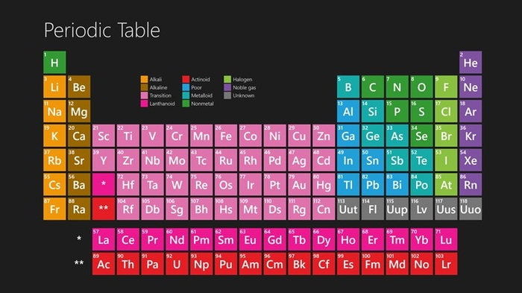
Atoms and the periodic Table
This Photo by Unknown Author is licensed under CC BY-SA

Slide 2
Atoms
Consist of a:
Nucleus (Protons and neutrons)
Electrons – that travel in space about the nucleus

Slide 3
This Photo by Unknown Author is licensed under CC BY

Slide 4
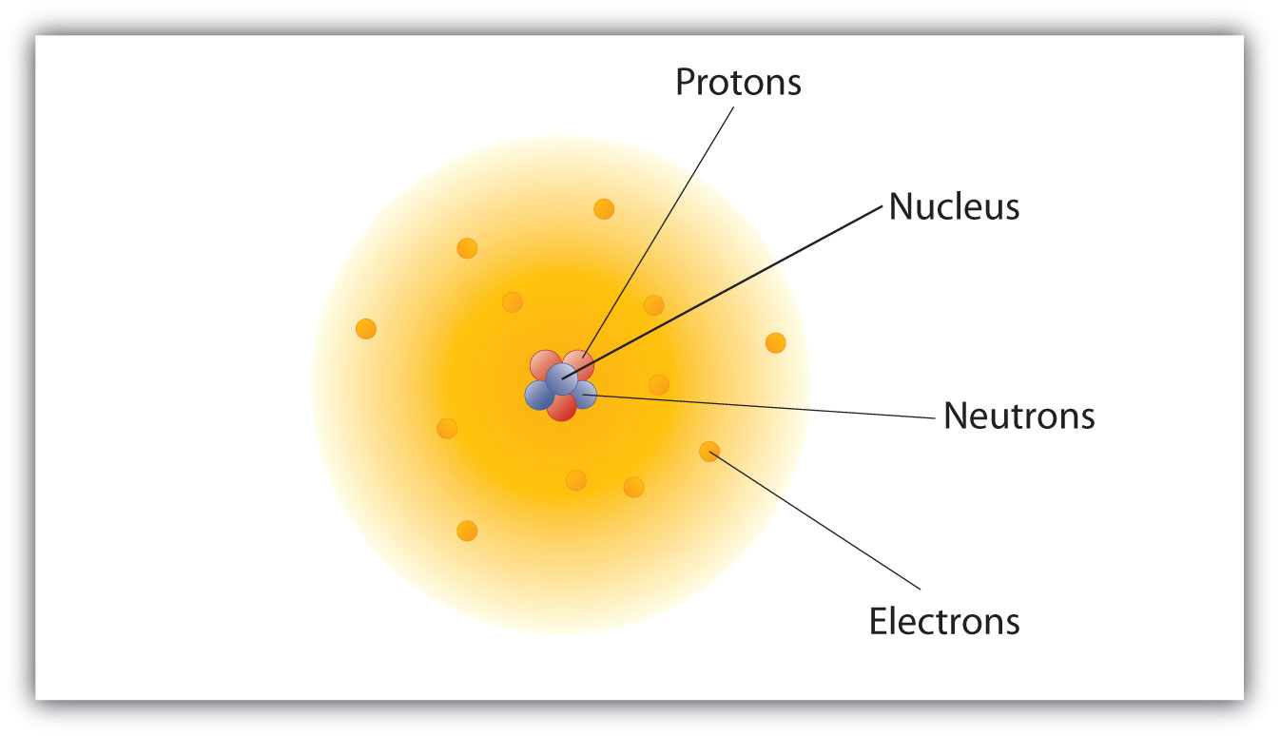
Atoms
Are mostly empty space.
Most of the mass of an atom is in the nucleus
Protons and neutrons have a mass of 1 amu.
Atomic mass = the number of protons and neutrons in the atom
This Photo by Unknown Author is licensed under CC BY-SA-NC

Slide 5
Atoms
Protons have a charge of +1
Electrons have a charge of -1
Neutrons have NO charge
This Photo by Unknown Author is licensed under CC BY-NC-ND

Slide 6
Electrons
The number of electrons in an element is the same as the number of protons.
This means that elements do not normally have a charge.
This Photo by Unknown Author is licensed under CC BY-NC-ND

Slide 7
Atomic number
The atomic number is the number of protons in the atom of the element.
Because the # of protons is equal to the # of electrons we can also tell the number of electrons from the atomic number.
This is an entry from the periodic table.

Slide 8
EXAMPLE
IF AN ELEMENT HAS 31 NEUTRONS AND 28 ELECTRONS THEN WHAT ELEMENT IS IT?

Slide 9
NICKEL
NUMBER OF NEUTRONS = Atomic Mass – Atomic Number

Slide 10
EXAMPLE
IF AN ELEMENT HAS AN ATOMIC MASS OF 184.
How many protons does it have?
How many electrons does it have?
How many neutrons does it have?

Slide 11
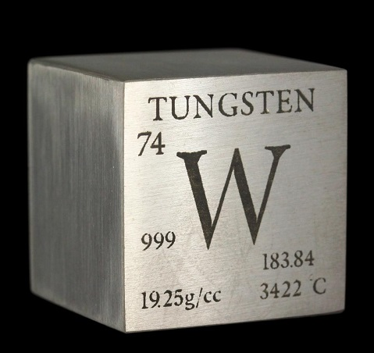
Tungston
ATOMIC MASS = 184
ATOMIC NUMBER = 74
74 PROTONS
74 ELECTRONS
110 NEUTRONS (184 – 74)
This Photo by Unknown Author is licensed under CC BY-NC-ND

Slide 12
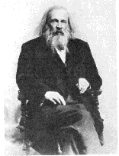
THE PERIODIC TABLE
Dmitri Mendeleev
1834 - 1907

Slide 13
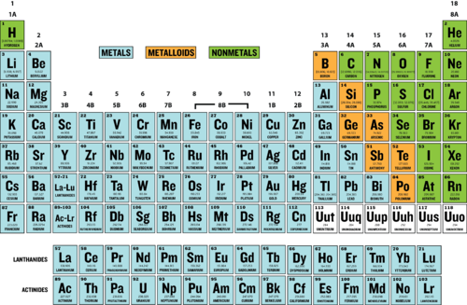
This Photo by Unknown Author is licensed under CC BY-NC

Slide 14
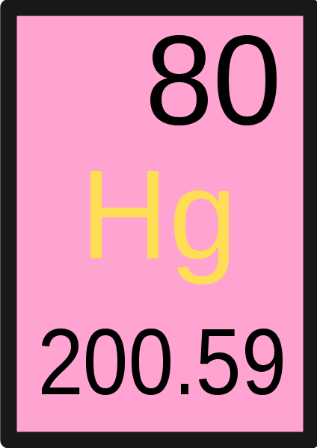
ELEMENTS
An individual square on the periodic table is called an Element.
This Photo by Unknown Author is licensed under CC BY-SA

Slide 15
Organization
Vertically into Groups
Horizontally Into Periods

Slide 16
Groups
Elements are arranged vertically into groups.
Elements in the same group tend to have similar properties.
This is because each atom in the same group have the same number of electrons in its outermost shell.
This outermost shell is known as a “Valence” shell.

Slide 17
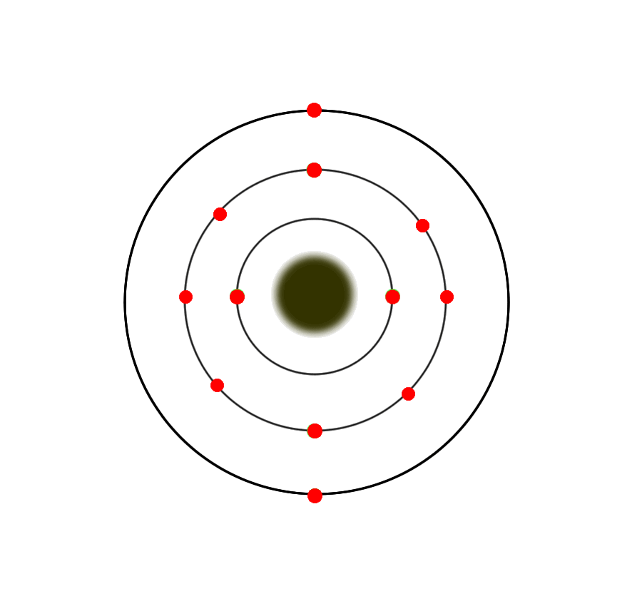
Groups
Be (Berilium) Mg (Magnesium)

Slide 18
Groups
The number of electrons in the Valence shell affects how the atom bonds.
The way an atom bonds affects many of the properties of an element.

Slide 19
Periods
Elements are arranged horizontally into Periods.
Elements in the same period have the same number of electron shells.

Slide 20
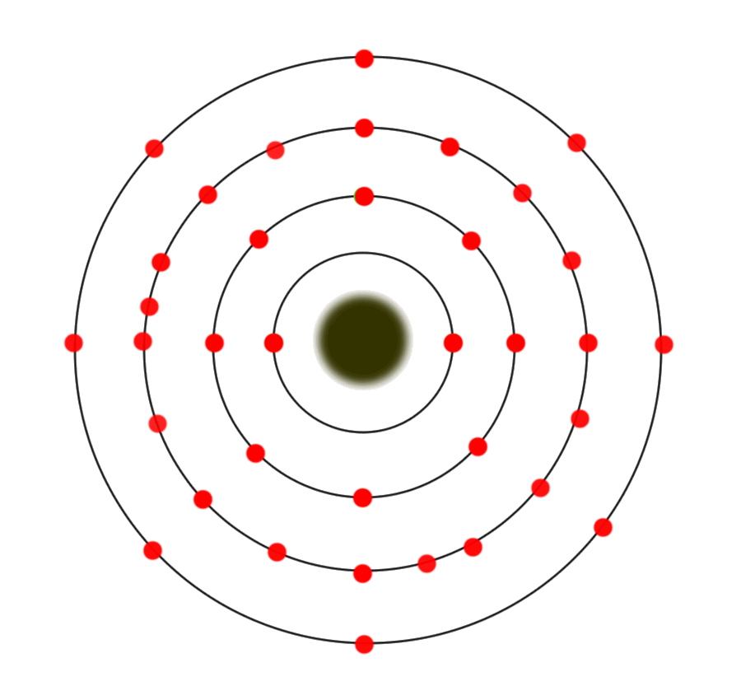
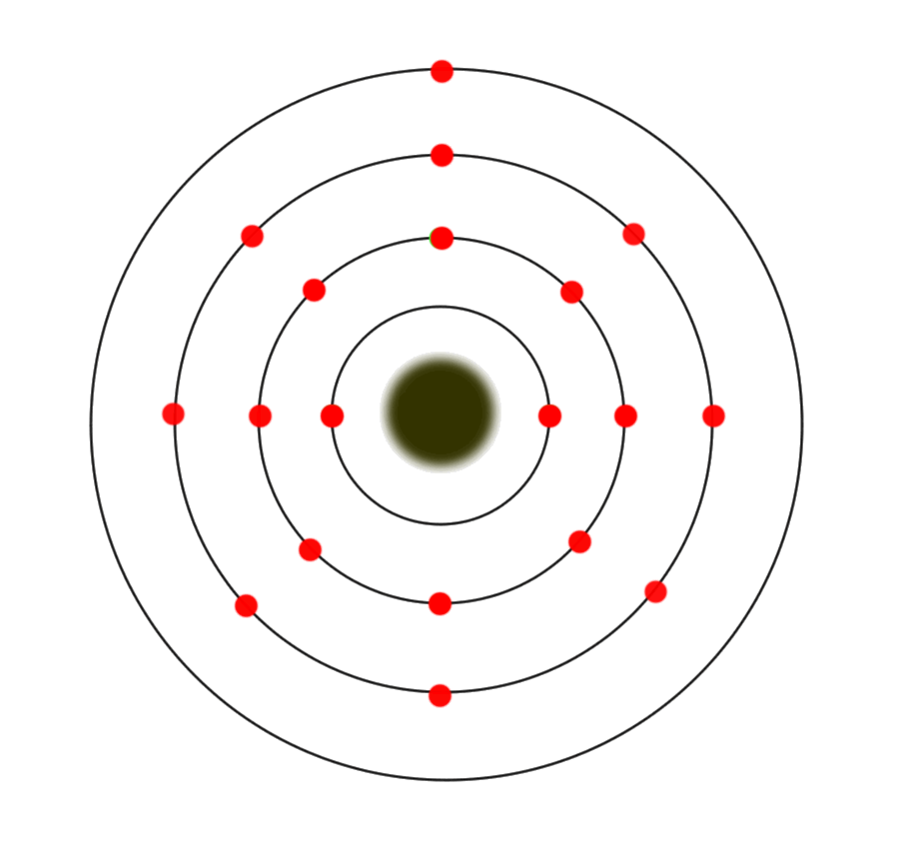
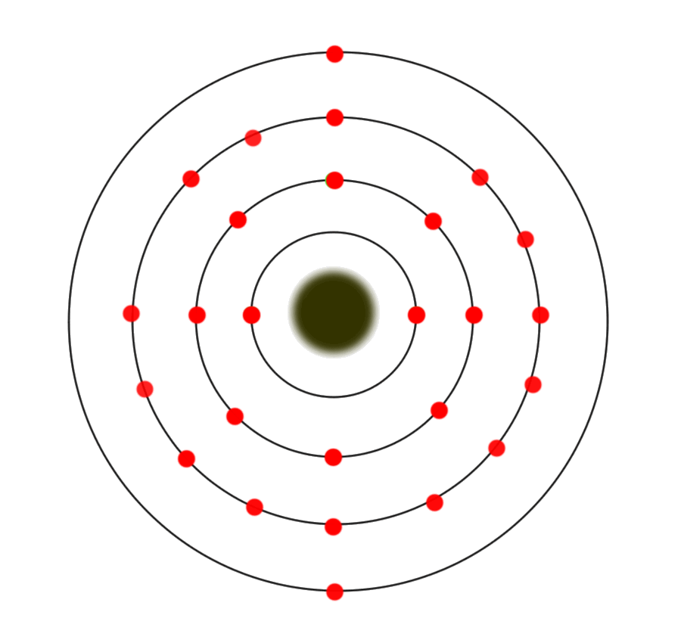
Periods
K (Potassium) Fe (Iron) Kr (Krypton)

Slide 21
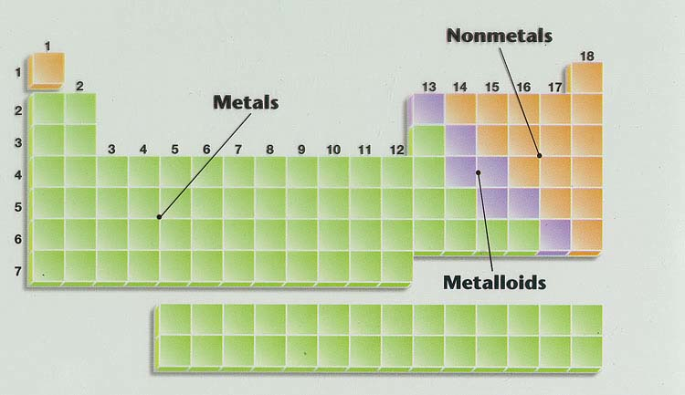
Families of the Periodic Table
The three main groups or families are the Metals, non-metals, and metalloids
This Photo by Unknown Author is licensed under CC BY-SA-NC

Slide 22
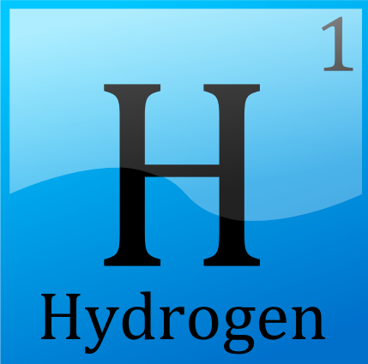
Hydrogen (PINK)
Does not match the properties of any other group so it is all alone.
Even though it is placed above group 1 it is not a part of that group.
Very reactive, colorless, odorless.
Gas at room temperature.
Has 1 outer level (valence) electron
This Photo by Unknown Author is licensed under CC BY-SA

Slide 23
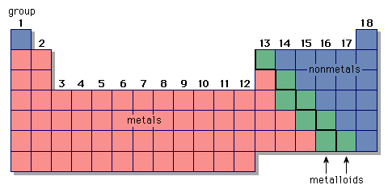
METALS (YELLOW)
~75% of the elements are metals.
solids at room temperature (except mercury)
Shiny, bendable (Malleable and ductile.
Good conductors of heat and electricity.

Slide 24
Non-metals (Orange)
Most are gases at room temperature.
Not shiny or bendable.
Generally not good conductors of heat and electricity.

Slide 25
Metalloids (PURPLE)
Lie on the “Staircase”
Share properties of both metals and non-metals.
Example: Silicon

Slide 26
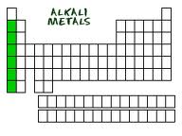
Alkali Metals (BLACK DOTS)
Group 1
Very reactive. (Never found in their pure form in nature)
Alkali metals have one valence electron.
Reactivity increases as you go down the group.
Soft, shiny, silvery colored metals (Soft enough to be cut by a knife)

Slide 27
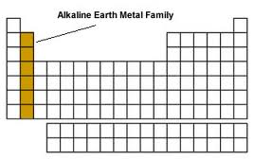
Alkaline Earth Metals (HORIZONTAL LINE)
Group 2
Silvery-White Metals
More dense than alkali metals
Fairly reactive (Slightly less than alkali metals)
Many are found in rocks in the earth’s crust
Alkaline earth metals have two valence electrons.

Slide 28
Transition Metals (DIAGONAL LINE)
Group 3 - 12
Moderate range of reactivity
Wide range of properties.
In general, shiny and good conductors of heat and electricity. Higher densities and melting points than groups 1 and 2
They have 1 or 2 outer level electrons.

Slide 29
Halogens (BROWN CIRCLE)
Group 17
All non-metals.
Very reactive
Often bond with Alkali metals because they have 7 valence electrons and alkali metals have 1 valence electron. Tend to form salts with metals (ex. NaCl)
Poor conductors of heat and electricity.

Slide 30
Halogens

Slide 31
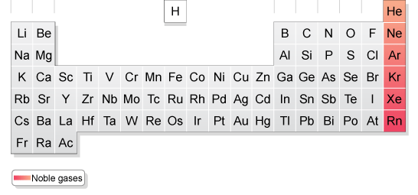
Noble Gasses (CHECKER BOARD)
Group 18
Non-reactive
Gases at room temperature.
Colorless and odorless
Noble gasses have eight valence electrons = stable octet
This Photo by Unknown Author is licensed under CC BY-SA
This Photo by Unknown Author is licensed under CC BY-SA

Slide 32
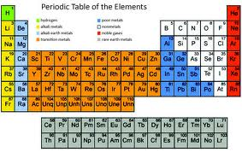
Actinide Series (GREEN)
Lanthanide
Series (RED)
Lanthanides - found naturally, only one is radioactive
Actinides - all radioactive, and some have only been made in particle accelerators.
These are also transition metals that were taken out and placed at the bottome so the table wouldn’t be too wide.
(Don’t worry about these)

