Slide 1
Biomagnification and Bioaccumulation

Slide 2
Definitions
Bioaccumulation:
is the accumulation of substances, such as pesticides, or other chemicals in an organism.
occurs when an organism absorbs a substance at a rate faster than that at which the substance is lost by catabolism and excretion.
This Photo by Unknown Author is licensed under CC BY-SA

Slide 3
Definitions
Biomagnification
the concentration of toxins in an organism as a result of its ingesting other plants or animals in which the toxins are more widely disbursed.
This Photo by Unknown Author is licensed under CC BY-SA

Slide 4
Common Toxins
PCBs (polychlorinated biphenyls): industrial chemical which has been banned in the US for decades, yet is still persistent
Pesticides: Glyphosate, atrazine, DDT
Heavy Metals: metals like arsenic, mercury, lead, aluminum and cadmium which are common in many areas of the environment

Slide 5
Problem with Toxins
Toxins, such as, pesticides can make their way into the water as well as onto the plants which they are targeting
1
Animals at the base of the food web (primary consumers) take in the toxins which are then passed up the food chain
2
Many toxins are fat soluble, not water soluble, which means that they are not secreted out through urine or sweat but rather stored in the tissues of the animals
3

Slide 6
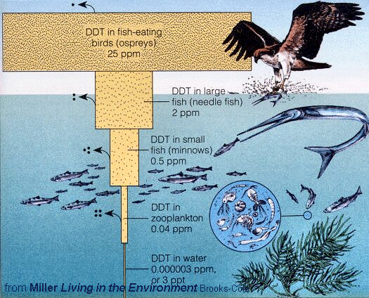
Biomagnification in Nature

Slide 7
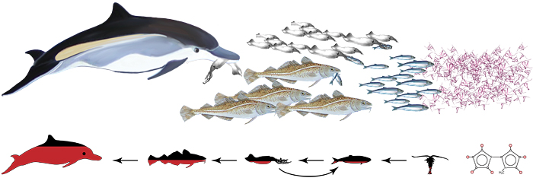
Interesting Information
Dolphins have been found to have a large amount of PCBs in them as a result of biomagnification.
The only way they can get rid of the toxins is through mothers milk to the offspring.
Results in a high mortality rate in offspring.

Slide 8
Food for Thought
Inuit people of Northern Canada have a diet of seals and as a result have a large accumulation of toxins in their bodies which in turn they use to pass to their children via breast milk.
Because the toxins in food chain could not be removed the mothers needed to be removed from the chain to protect the children (alter their diet)

