Slide 1
Bohr Model of the Atom

Slide 2
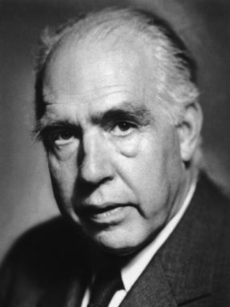
Niels Bohr (1885 – 1962)
This Photo by Unknown Author is licensed under CC BY-NC-ND

Slide 3
Atom Structure Reminder
Atoms have a nucleus made up of Protons and Neutrons.
Electrons are contained in shells that surround the nucleus.
An atom is mostly empty space.
Protons are positively charged (+1)
Electrons are negatively charged (-1)
Neutrons have no charge.

Slide 4
Valence Electrons
Electron Shell | Number of Electrons
1 | 2
2 | 8
3 | 8
4 | 18
5 | 18
6 | 32
7 | 32
Each electron shell can hold a certain number of electrons.
Shells are filled from the inside out
Noble gases have full outer electron shells.
All other elements have partially filled outer shells.

Slide 5
Valence Electrons
Electrons in the outer most electron shell are called valence electrons
The shell furthest from the nucleus that contains electrons is called the valence shell.
The number of electron shells with electrons is the same as the period number.
Atoms will try to gain or lose electrons to have a full valence shell.

Slide 6
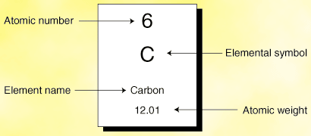
Bohr Diagrams
STEP 1: Find your element on the periodic table.
Step 2: Determine the number of electrons (Same as the atomic number)
This Photo by Unknown Author is licensed under CC BY-NC

Slide 7
Bohr Diagrams
STEP 3: Find out what period (row) your element is in.
Elements in the first period have one energy level.
Elements in the second period have two energy levels
An so on…..
This Photo by Unknown Author is licensed under CC BY-NC

Slide 8
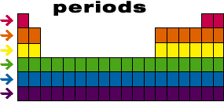
Energy levels
1st Period has one energy level
2nd Period has two energy levels

Slide 9
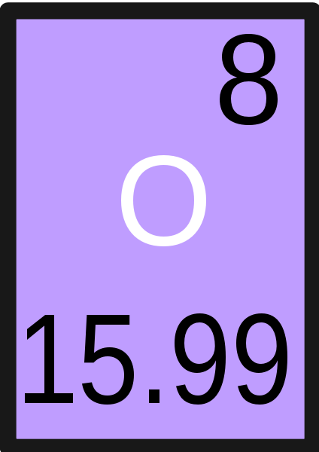
Bohr Diagram EXAMPLE
Oxygen
Draw the number of Protons and neutrons in the nucleus.
Oxygen is in the 2nd Period so it has two shells.
Draw shells around nucleus.
8p
8n
This Photo by Unknown Author is licensed under CC BY-SA

Slide 10
Bohr Diagram EXAMPLE
Oxygen
Add electrons to your diagram.
Oxygen has 8 electrons.
Remember the first shell can only hold 2 electrons.
8p
8n

Slide 11
Bohr Diagram EXAMPLE
Oxygen
Once the first shell has its maximum electron number (Which is 2), count the remaining electrons.
The remaining electrons go in the second shell until it is full.
Add one at a time starting on the right and going counter clock-wise.
8p
8n

Slide 12
Bohr Diagram EXAMPLE
Oxygen
Double check.
You should have 8 electrons total for Oxygen.
There should be only 2 electrons in the first shell, 8 electrons in the second.
8p
8n

