Slide 1
What is Chemistry?
And WHY?

Slide 2
Chemistry
The study of substances and the changes these substances undergo.

Slide 3
Physical Changes
During a physical change, the properties of a substance may change, but its chemical identity remains the same.
Example: Is water still H₂O if its frozen or gas?

Slide 4
Chemical Changes
Result in the formation of new substances.

Slide 5
Chemical Reactions
The process in which one or more substances undergo a chemical change to produce one or more new substances.

Slide 6
Describing chemical reactions
Elements and compounds interact with one another to form new substances.
A substance that undergoes a chemical reaction is called a reactant.
A substance that is formed in a chemical reaction is called a product.

Slide 7
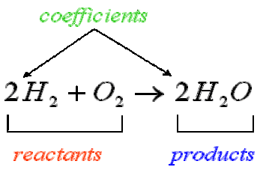
This Photo by Unknown Author is licensed under CC BY-SA

Slide 8
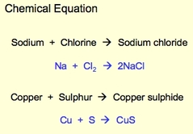
Word Equations
Identify the reactants and products of a chemical reaction by name
Example:
This Photo by Unknown Author is licensed under CC BY-SA

Slide 9
Skeleton Equation
Lists the chemical formula of each reactant on the left, separated by a + sign if more than one reactant is involved, followed by an arrow

Slide 10
This Photo by Unknown Author is licensed under CC BY-SA

Slide 11
Balancing Chemical Equations
Many equations are not balanced.
In order to do so, you can add numbers in front of the appropriate formulas.
The numbers that are placed in front of chemical formulas are called coefficients.
They represent how many of each atom, molecule, or formula unit take part in each reaction.

Slide 12
EXAMPLE
Na + Cl₂ NaCl
Is this balanced?
NOTE: You cannot balance an equation by changing any of the chemical formulas.
Why?

Slide 13
Make a table (it can help)
Na + Cl₂ NaCl
Element | Reactant Side | Product Side
Na | 1 | 1
Cl | 2 | 1
SO…. Since there are uneven amounts of an element on opposite sides of a reaction we need to add coefficients to balance the equation.

Slide 14
Make A table
2Na + Cl₂ 2NaCl
Element | Reactant Side | Product Side
Na | 2 | 2
Cl | 2 | 2

