Slide 1
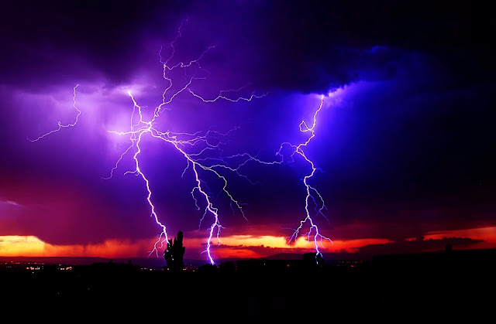
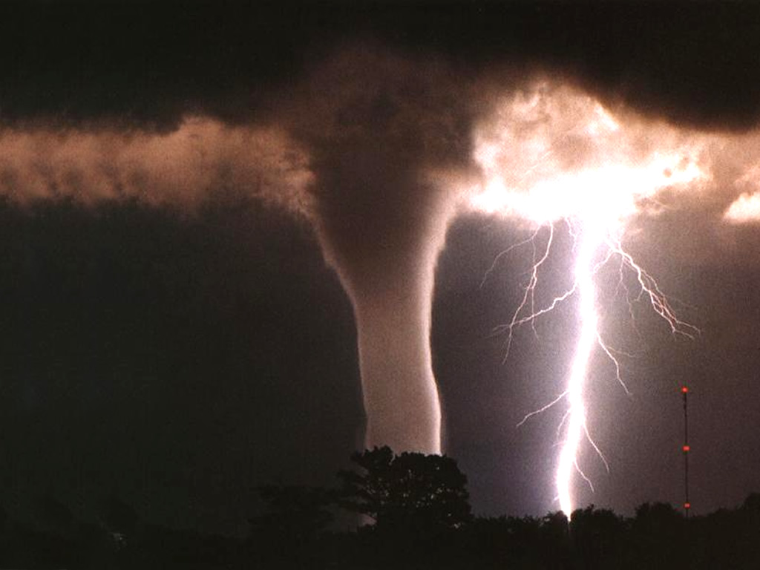
WEATHER VS CLIMATE
This Photo by Unknown Author is licensed under CC BY-SA
This Photo by Unknown Author is licensed under CC BY

Slide 2
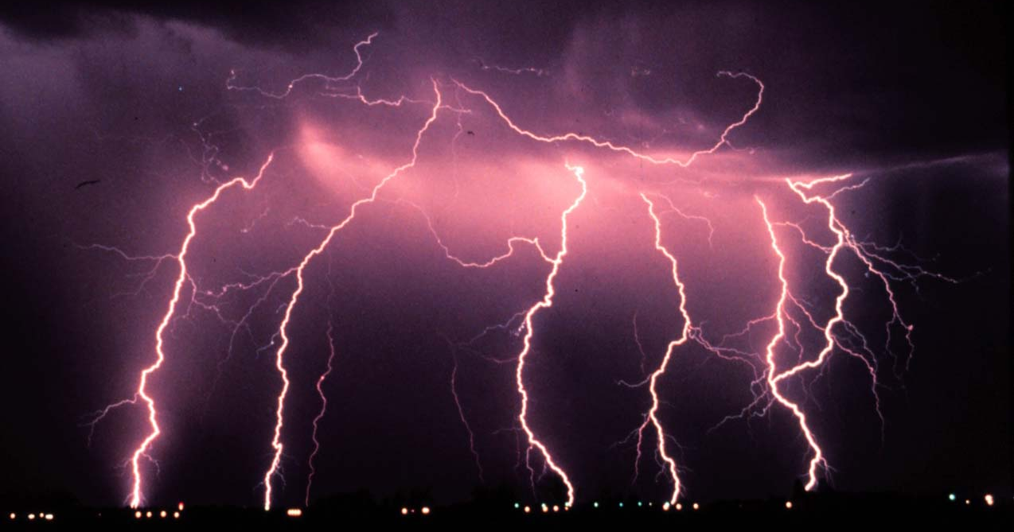
What is weather?
This Photo by Unknown Author is licensed under CC BY-SA-NC

Slide 3
Weather
Can be define as “the way the atmosphere is behaving, mainly with respect to its effects upon life and human activities.”
Weather consists of the short term changes in the atmosphere. (Minutes to months)
Weather effects can include: temperature, humidity, precipitation, cloudiness, brightness, visibility, wind, and atmospheric pressure, as in high and low pressure.
Notes:
https://www.nasa.gov/mission_pages/noaa-n/climate/climate_weather.html

Slide 4
Climate
Can be define as the average of weather over time and space.
Climate consists of changes in long-term averages of daily weather.
There can also be short-term changes in climate due to many factors, such as: El Niño, La Niña, volcanic eruptions, or other changes in the Earth system.
Notes:
https://www.nasa.gov/mission_pages/noaa-n/climate/climate_weather.html

Slide 5
So what is the difference
Weather
Climate
can change from minute-to-minute, hour-to-hour, day-to-day, and season-to-season. (In most places)
What you get, like a hot day with pop-up thunderstorms
Dress for the weather
is the average of weather over time and space.
What you expect, like a hot summer.
Build your house for the climate
Notes:
https://www.nasa.gov/mission_pages/noaa-n/climate/climate_weather.html

