Slide 1
Lewis dot Structure

Slide 2
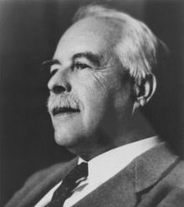
Gilbert N. Lewis (1874 – 1946)
This Photo by Unknown Author is licensed under CC BY-SA
This Photo by Unknown Author is licensed under CC BY-NC-ND

Slide 3
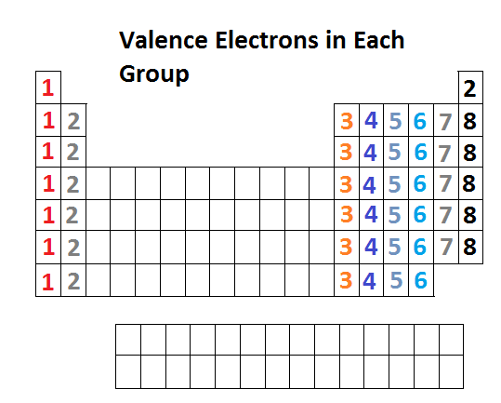
Valence Shells
A valence shell is the outermost shell of an atom.
Electrons in the outer “valence” shell are most likely to contribute to how an element reacts.
This Photo by Unknown Author is licensed under CC BY-SA-NC

Slide 4
Lewis Dot Model
Just like the Bohr model, the Lewis dot model is a method for scientists to show the electrons of an atom.
Unlike the Bohr model, the Lewis model only displays the valence shell electrons.

Slide 5
Steps to a Lewis Dot model
Step 1: Determine the number of Electrons for your element.
Step 2: Draw the symbol of the element.

Slide 6
Steps to a Lewis Dot model
Step 3: Begin placing the valence electrons around your symbol starting at the right and working counter clock-wise.

Slide 7
Lewis Dot Example
Nitrogen
Carbon

