Slide 1
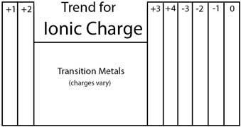
Trend In Charge
1 2 13 14 15 16 17 18

