Slide 1
Food Chains
Energy Flow in Ecosystems
(WHO EATS WHO)

Slide 2
What is a food chain?
a hierarchical series of organisms, each dependent on the next as a source of food.

Slide 3
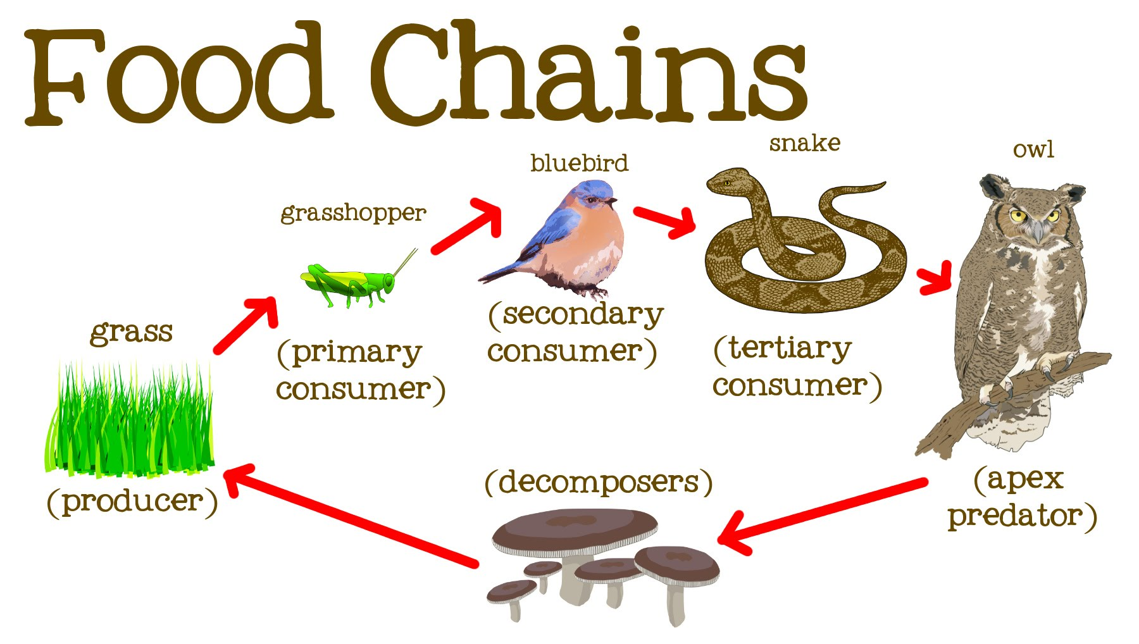
Food Chain
A food chain describes the different levels at which organisms eat and the direction that energy flows within the ecosystem.

Slide 4
Trophic Levels
Definition: How the levels of hierarchy in the food chain are divided.
Trophic levels are the individual levels of the hierarchy in which organisms share the same function in the food chain and the same nutritional relationship to the primary sources of energy.
The most common trophic levels are:
Producer
Primary Consumer
Secondary Consumer
Tertiary consumer
Apex predators
Decomposers

Slide 5
Producers
Producers are organisms that make their own food; they are also known as autotrophs. They get energy from chemicals or the sun, and with the help of water, convert energy into a useable form such as sugar.
This usable form of energy or food can then be used by an organism at a higher trophic level.
The most common example of a producer are plants.
This Photo by Unknown Author is licensed under CC BY-ND

Slide 6
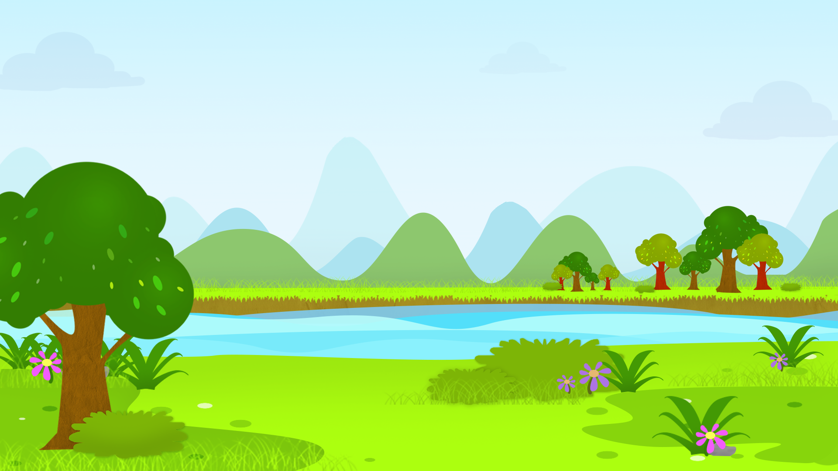
Where does the energy in a food chain start?
This Photo by Unknown Author is licensed under CC BY-NC-ND

Slide 7
Consumers
After producers there are consumers.
Consumers, also called heterotrophs, are species that must obtain their energy from eating other organisms, either plants or animals.

Slide 8
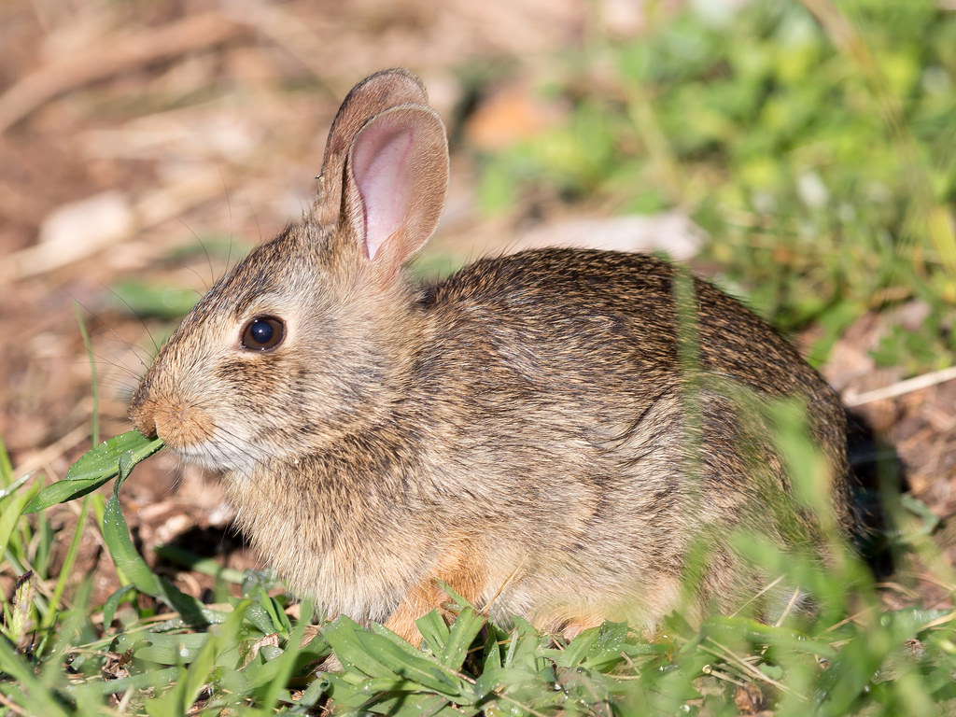
Primary consumers
an organism that feeds on primary producers.
are usually herbivores that feed on autotrophic plants
This Photo by Unknown Author is licensed under CC BY

Slide 9
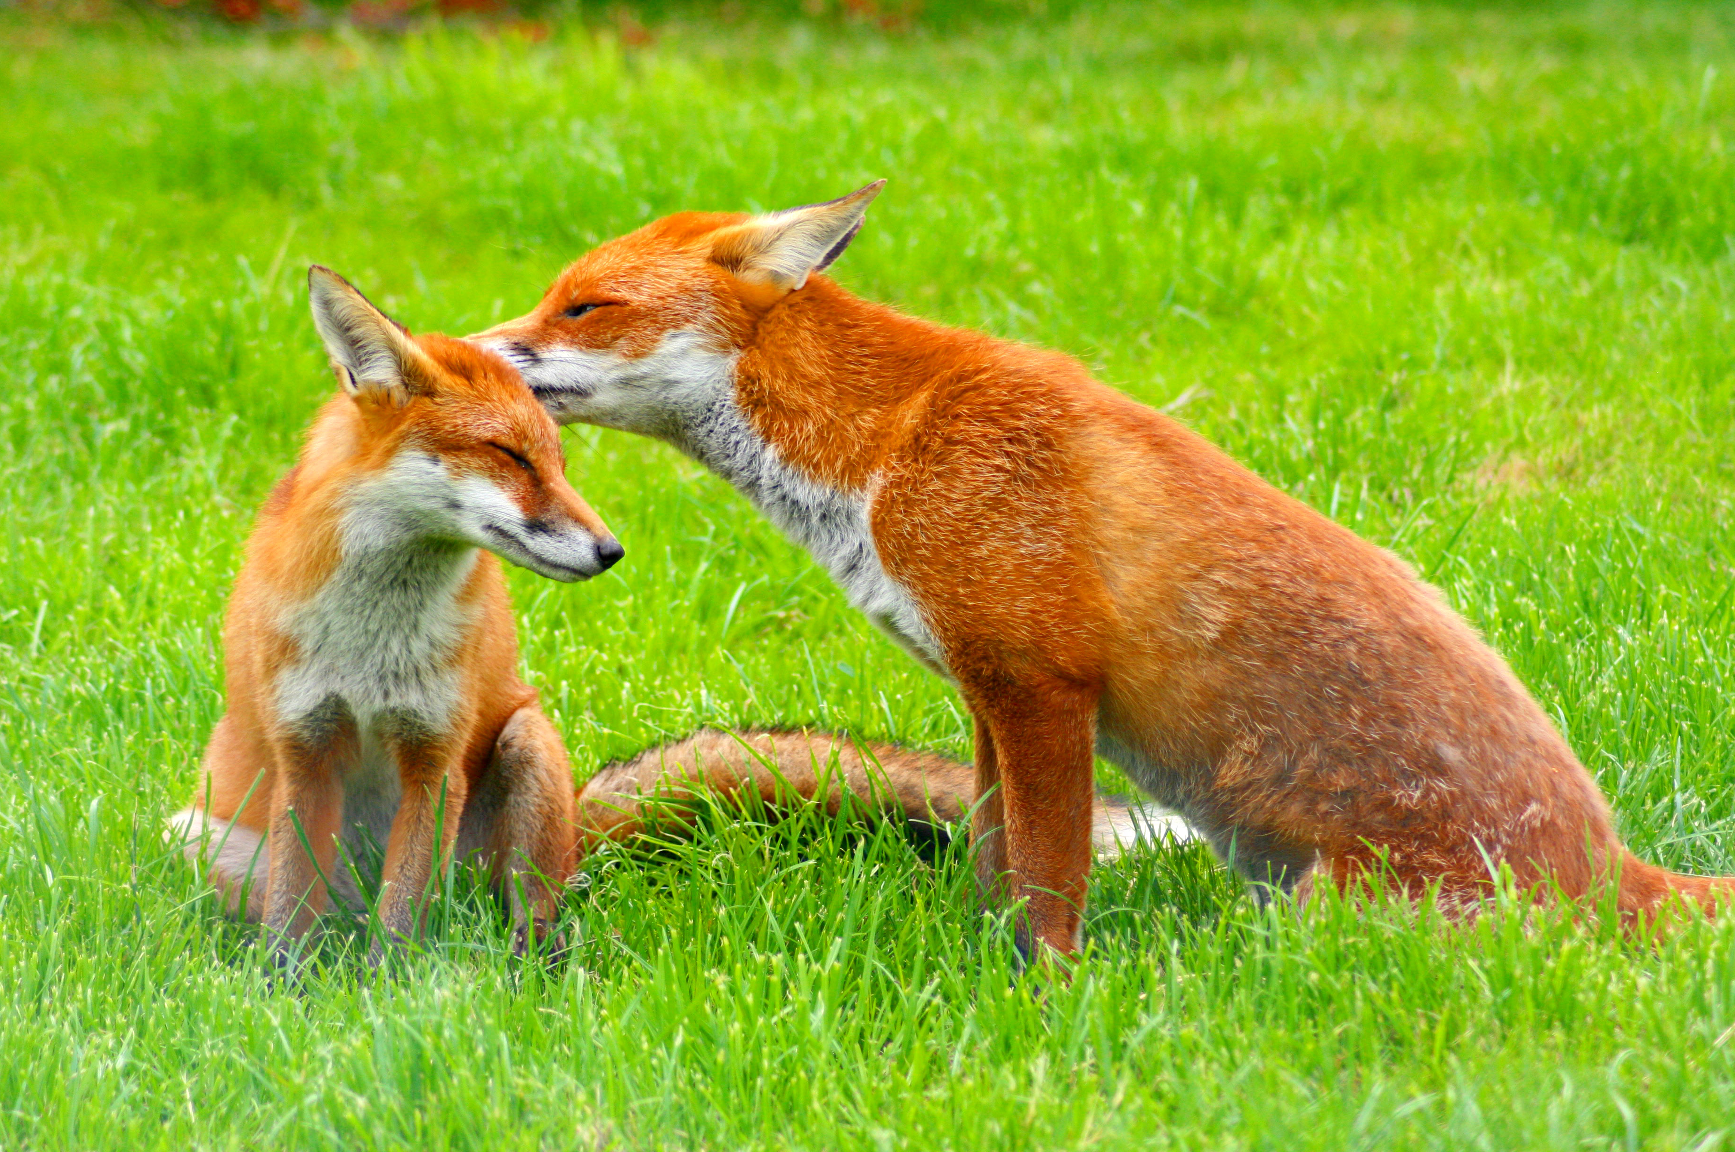
Secondary consumers
Consume the animals that eat only plants.
This Photo by Unknown Author is licensed under CC BY-SA

Slide 10
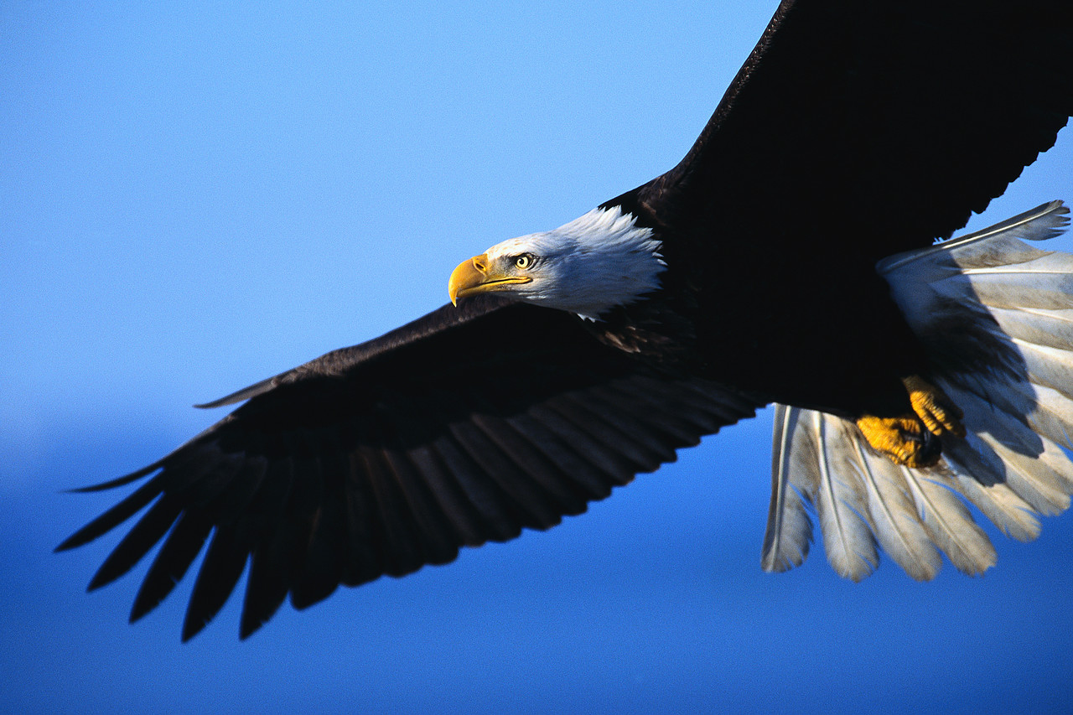
Tertiary consumers
Carnivores at the topmost level in a food chain that feeds on other carnivores.
Can also eat primary consumers.
This Photo by Unknown Author is licensed under CC BY-SA-NC

Slide 11
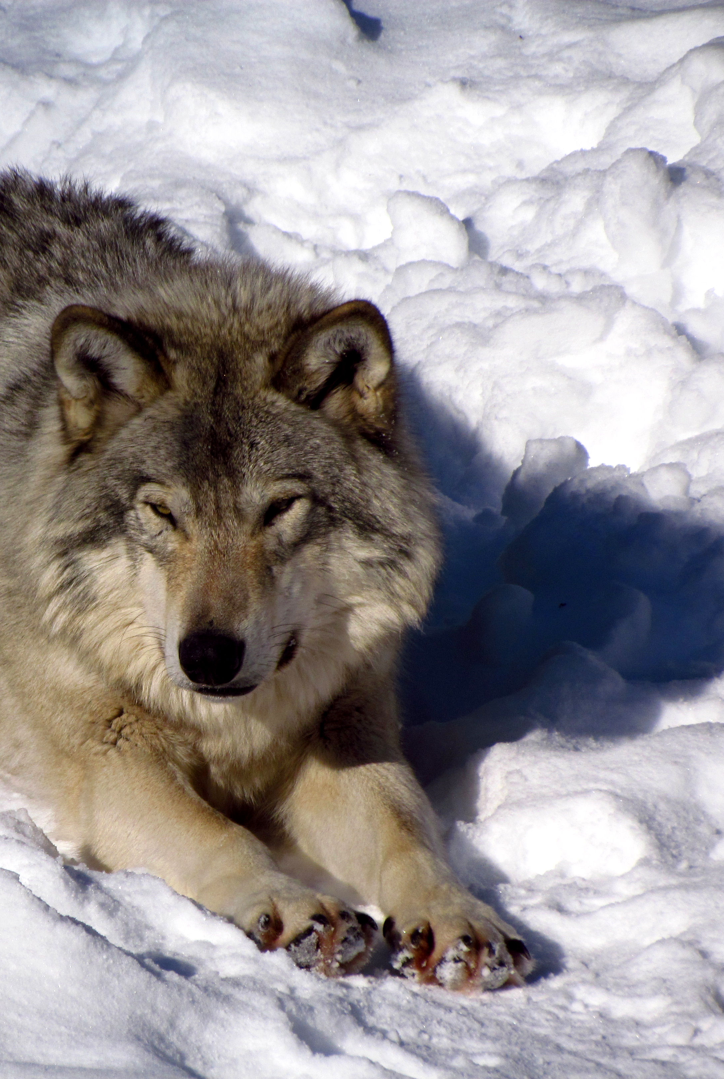
Apex Predators
also known as an alpha predator or top predator,
A predator that is at the top of a food chain, with no natural predators.
In terms of trophic levels, they occupy the highest trophic level.
Examples: Wolf, Eagle
This Photo by Unknown Author is licensed under CC BY-SA

Slide 12
Food chain video

Slide 13
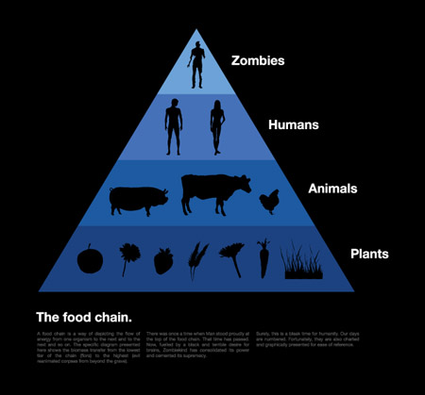
What are humans on the food chain?
This Photo by Unknown Author is licensed under CC BY-NC-ND

Slide 14
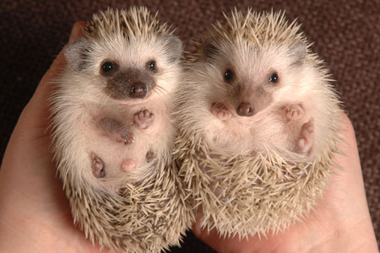
HUMANS
Not all humans are in the same trophic level.
Humans are omnivores, which means that they consume both plant and animal material.
Other examples include: Bears, Hedgehogs
This Photo by Unknown Author is licensed under CC BY-SA
This Photo by Unknown Author is licensed under CC BY-NC-ND

Slide 15
What is a Food Web?
a system of interlocking and interdependent food chains.

Slide 16
This Photo by Unknown Author is licensed under CC BY-ND

Slide 17
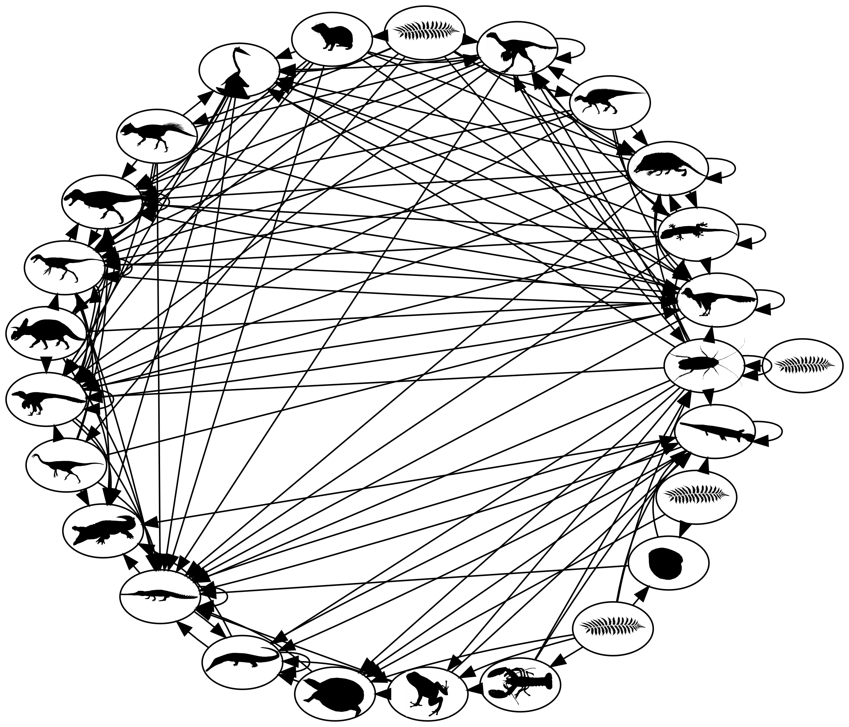
Simple or complex
A food web can be as simple as the previous web or as complicated as the one to the left.
This Photo by Unknown Author is licensed under CC BY-NC-ND

Slide 18
WHY FOOD CHAINS?
Food chains let us understand what eats what in an ecosystem.
If we know this, we can identify important species to the ecosystem.
If we know the food chain, we can predict the outcome of losing one of the species.
Knowing the food chain can let us know the way energy and even toxins flow within an ecosystem.
Example: If wolves are removed due to overexploitation (hunting) what happens to the other species?
(There is a population increase in small herbivores, which leads to a decline in biodiversity because they eat all the small vegetation)
Example 2: If there are lots of one type of insect due to increasingly warm temperatures, what happens to the population of the birds who eat them?
(There is a population increase in the birds)

