Slide 1
Energy and Collision Theory

Slide 2
Energy change in reactions
Take a look at this reaction.
A+B → C +energy ∆H = negative

Slide 3
Energy change in reactions
Take a look at this reaction.
A+B + energy → C ∆H = positive

Slide 4
Collision Theory
States that when particles of the reactants hit each other, a certain fraction of the collisions cause any noticeable or significant chemical change;
Successful collisions must have enough energy, also known as activation energy, at the moment of impact to break the preexisting bonds and form all new bonds. This results in the products of the reaction.

Slide 5
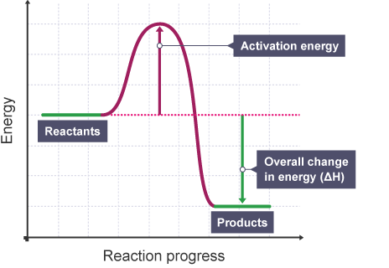
Activation Energy
Activation energy is the amount of energy needed by the reactants for a collision to result in a product.
The overall change in energy (∆H) is the energy that is either released or absorbed during the reaction.
This Photo by Unknown Author is licensed under CC BY-SA

Slide 6
Activation Energy
If the final energy level is lower than the starting energy of the reaction, then ∆H is negative and the reaction is exothermic.
If the final energy level is higher than the starting energy of the reaction, then ∆H is positive and the reaction is endothermic.

Slide 7
Reaction Rates
Activation energy is the major barrier to how fast a reaction occurs.
So there are things that can be done to affect the reaction rate.

Slide 8
Factors that affect Reaction Rate
Surface area
Concentration
Pressure
Temperature
Catalysts/Inhibitors

