Slide 1
Invasive Species Management
z
Rediscovering Natural Ways

Slide 2
How do we control invasive species?
Prevention
Mechanical Control
Manual Control
Chemical Control
Biological Control
z

Slide 3
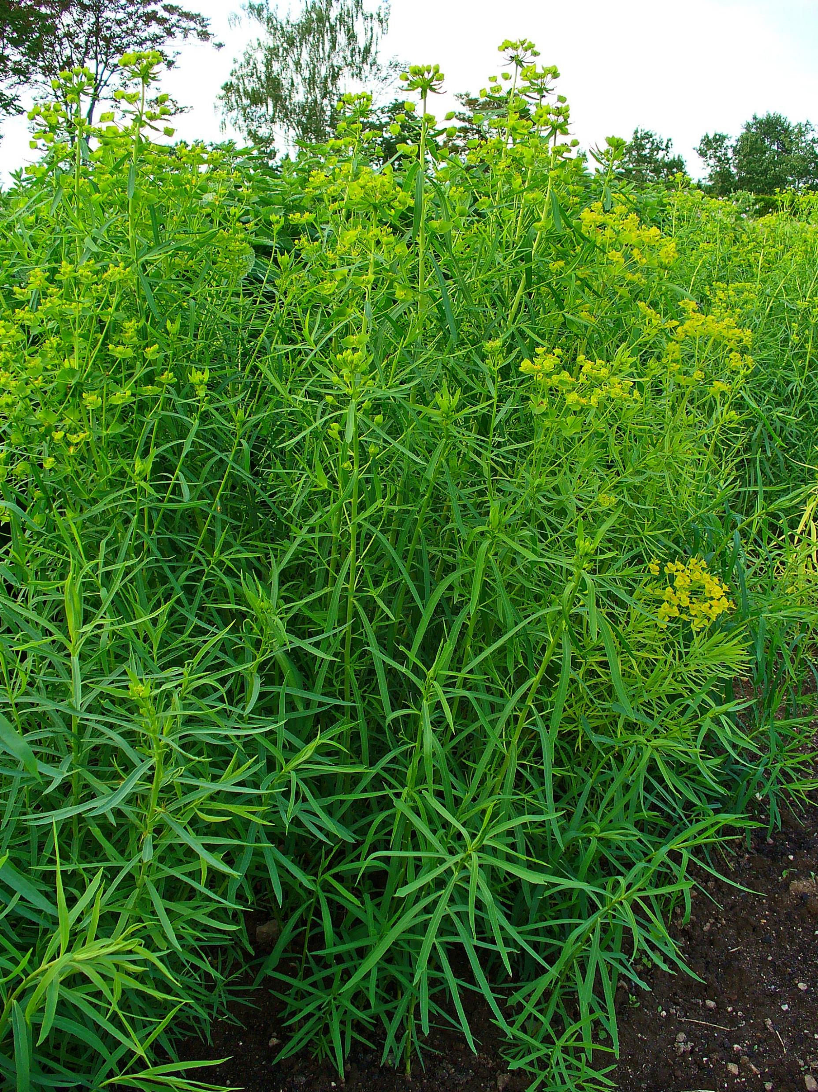
Prevention
Leafy Spurge
z
Focuses on stopping invasive species before they get into the natural ecosystem.
The government manages this.
The government may recommend not planting or regulate with laws preventing the import of species it deems too risky.
This Photo by Unknown Author is licensed under CC BY-SA

Slide 4
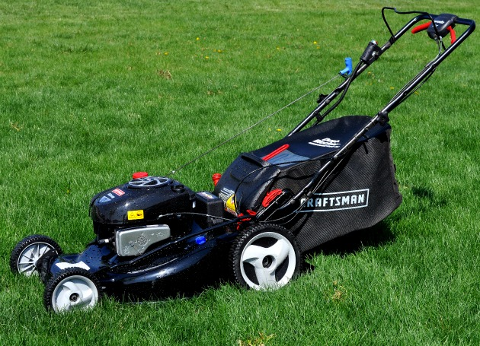
Mechanical Management
z
This would include methods such as mowing.
The drawback of this method is that plants must be cut down before they go to seed and sometimes must be cut down multiple times.
This Photo by Unknown Author is licensed under CC BY-SA

Slide 5
Manual Management
z
Includes: Hand pulling and digging.
This method is good for environmentally sensitive areas, where chemical or biological methods would be risky.
The drawback is that this method is very time and labour intensive (SLOW)
This Photo by Unknown Author is licensed under CC BY-NC-ND

Slide 6
Chemical Management
z
This is typically what most people think of when thinking about invasive species management.
Would include: Pesticides, Herbicides, etc.
Advantages: Quick and easy to deploy
Drawbacks: Can have negative impacts on surrounding non-target plants.

Slide 7
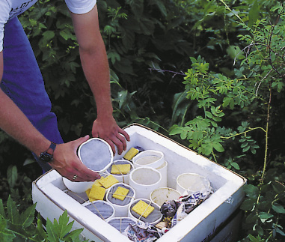
Biological Management
z
Would include importing insects that feed on the invasive species.
Example: Leafy Spurge beetle
This Photo by Unknown Author is licensed under CC BY-SA-NC

Slide 8
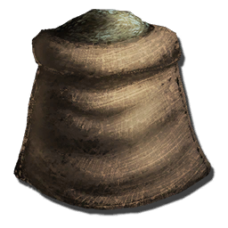
Cultural Methods
z
Includes: Re-vegetating, irrigating or fertilizing to encourage the establishment of a healthy ground or crop cover to resist invasive plants.
This Photo by Unknown Author is licensed under CC BY-SA-NC

Slide 9
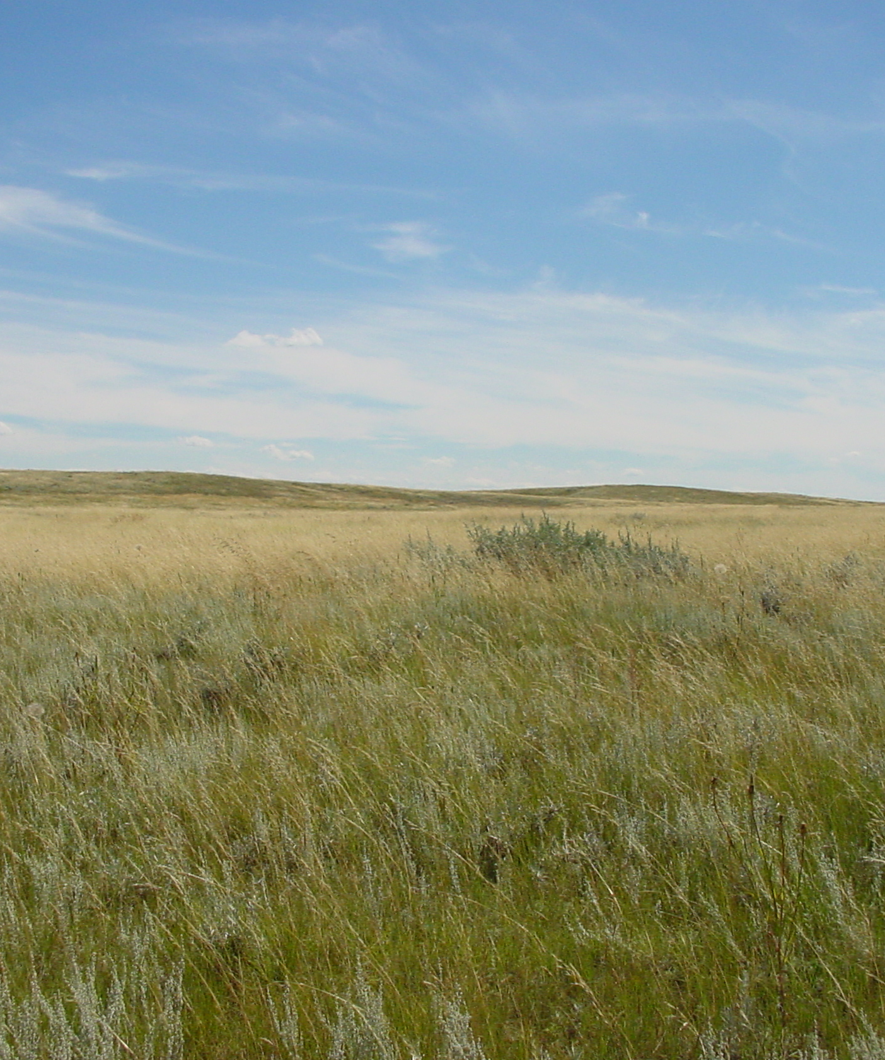
Rediscovering Ways
z
Natural Methods
Traditional Indigenous Methods
This Photo by Unknown Author is licensed under CC BY-SA

Slide 10
Natural Methods
Mimicking Ecosystem Specific Grazing
Example: Bison on Saskatchewan Grasslands
Both removes invasive species and helps re-vegetate natural ground cover.
Bison Sheep on the NE Swale

Slide 11
Traditional Indigenous Methods
Controlled Burning
Both removes invasive species and aids in the regrowth of a biologically diverse ecosystem.
Example: Burning Invasive Species infested areas and re-establishing native prairie ecology.
Fire Keepers
Controlled Burning

