Slide 1
Ionic to covalent compounds
What is the difference?

Slide 2
Ionic Bonds
These bonds form only between metals and non-metals.

Slide 3
Ionic Bonds
Exchange electrons.
The metal ion “cation” loses electrons and becomes positively charged.
The non-metal “anion” gains electrons and becomes negatively charged.
This Photo by Unknown Author is licensed under CC BY-NC-ND

Slide 4
Properties of Ionic Compounds
Ionic compounds have high melting and boiling points.
Ionic compounds conduct electricity when dissolved in water or molten.
Ionic compounds rarely burn.
Ionic compounds are hard and brittle.
Ionic compounds form crystals.

Slide 5
Covalent Bonds
These bonds form only between non-metals.

Slide 6
Covalent Bonds
Share Electrons to fill their valence shells.
Do not have charges.

Slide 7
Valency
The number of electrons in the outer shell of an atom which are able to be used to form bonds with other atoms.

Slide 8
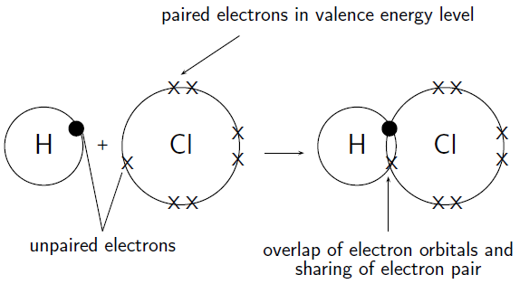
Covalent Bond Forming

Slide 9
Examples
O₂
NH₃

Slide 10
O₂

Slide 11
NH₃

Slide 12
Covalent Bonds
These bonds form only between non-metals.
Share electrons to fill valence shell.
Only Share unpaired electrons.

Slide 13
Properties of Covalent Bonds
Covalent compounds have low melting and boiling points.
Covalent compounds never conduct electricity.
Covalent compounds burn more frequently.
Covalent compounds have a wide variety of textures.
Covalent compounds have many different appearances.

