Slide 1
Artificial Selection Activity

Slide 2
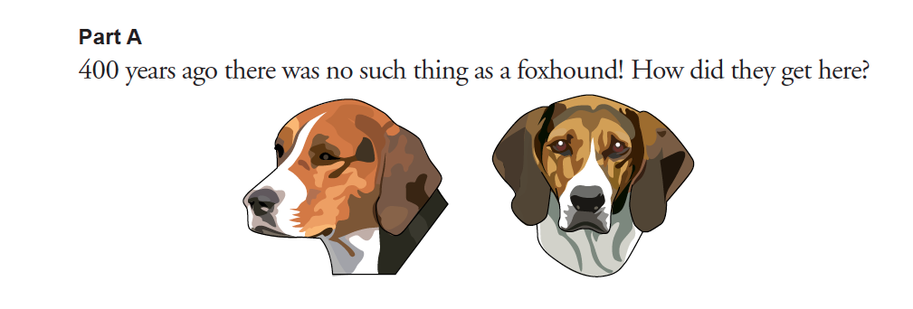
American Foxhound

Slide 3
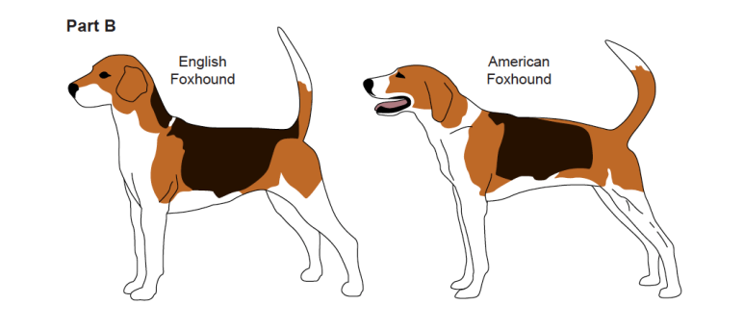
The American Foxhound is half descended from the English Foxhounds that were brought to America in 1650. The English hounds were crossed with a French hound that George Washington received as a gift from Lafayette. The combination breed became an excellent hunter of wild animals. The American Foxhound has great speed and an excellent sense of smell. It can run at high speed for long periods and has a musical bay that is easy to follow. American Foxhounds are still used as hunting dogs today but are also used as companions and watchdogs.

Slide 4
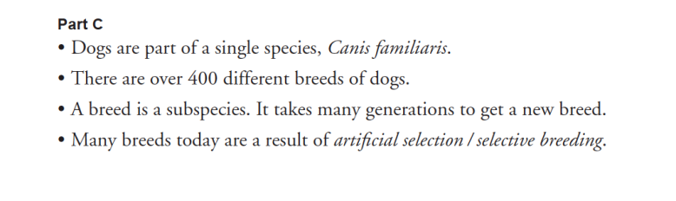
All dogs are from the same species, Canis familiaris. Therefore, it is possible to select dogs to breed for particular traits.
What features or abilities of dogs might humans want to breed for?

Slide 5
Which traits would be most appropriate to match the example given?
Which breeds would probably be best to cross?

Slide 6
Physical traits serve a very specific function for dogs. Each of these could play an important role, or have significance for humans when they need a dog to perform a particular function
What significance can each trait have?

Slide 8
DIVIDE INTO GROUPS OF 3
GRAB DOG PACKET
Each group will be trying to artificially select a new dog with certain traits by crossing two existing breeds
Take out “ownership card” and fill it out. The “dog breeds” handout contains the breeds you may use.

Slide 9
Artifcial Selection
Artifcial selection happens when people select individuals to mate that have features they hope the offspring will inherit. This is also called selective breeding.
Here is what is required:
Variation: The differences that exist among individuals. Many of these differences are determined by their genes.
Inheritance: Genetic traits are inherited from parents and are passed on to offspring.

Slide 10
Artifcial Selection
Selection: In artifcial selection, individuals with favorable traits are bred in the hopes that those traits will be passed on to the next generation.
Time: Getting the desirable features does not usually happen in just one try. Often, you have to breed many generations to get a new breed established.

