Slide 1
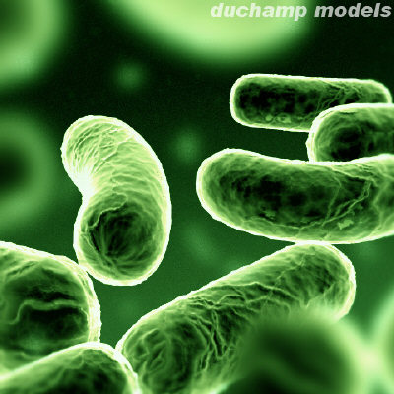
BACTERIA

Slide 2
Kingdom Eubacteria (True Bacteria)
Bacteria are located everywhere – air, water, land, and living organisms including people.
General Characteristics:
1. All are unicellular (one-celled structural level)
2. All are prokaryotic - cells that lack nucleus (no nuclear envelope) (PRO = NO nucleus)
3. All have cell walls – NO cellulose in cell walls
4. Can live in both aerobic (with O₂) and anaerobic (without O₂) environments

Slide 3
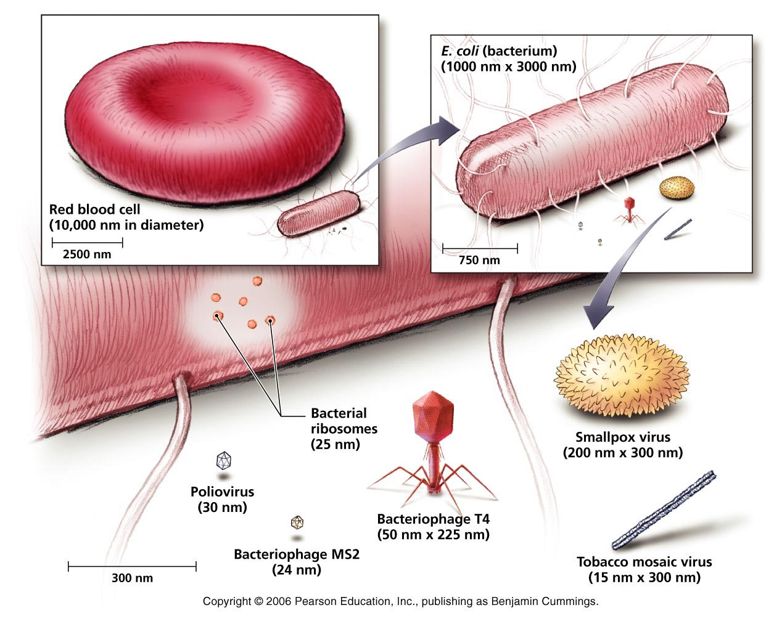
5. Bacteria are much larger in size than viruses.

Slide 4
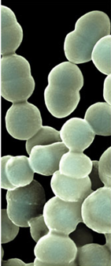
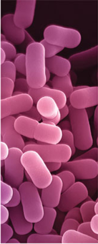
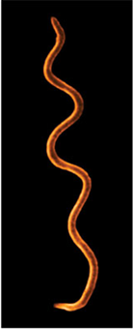
6. Bacteria usually have one of three different cell shapes:
Coccus
(Sphere-shaped)
Ex: Streptococcus
Bacilli
(rod-shaped)
Ex: Lactobacillus
Spirillum
(Spiral-shaped)
Ex: Spirillium

Slide 5
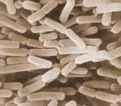
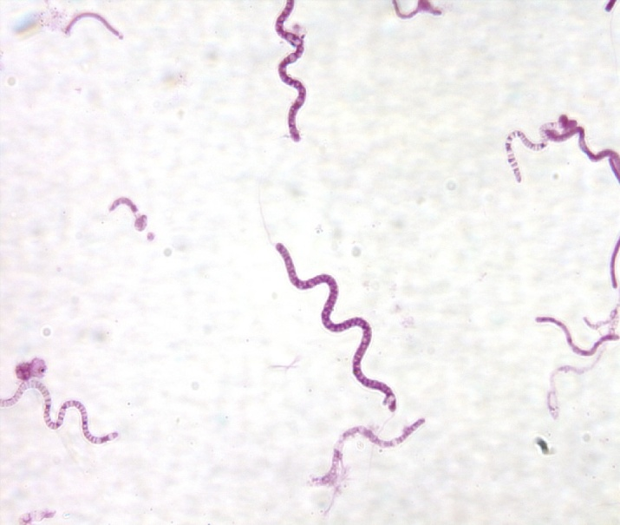
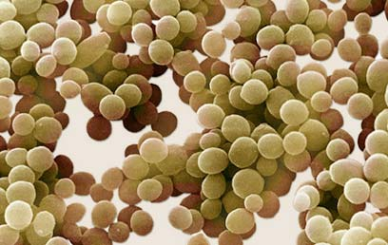
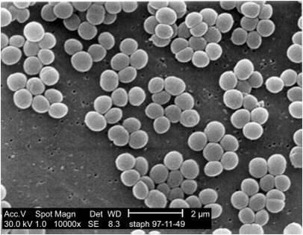
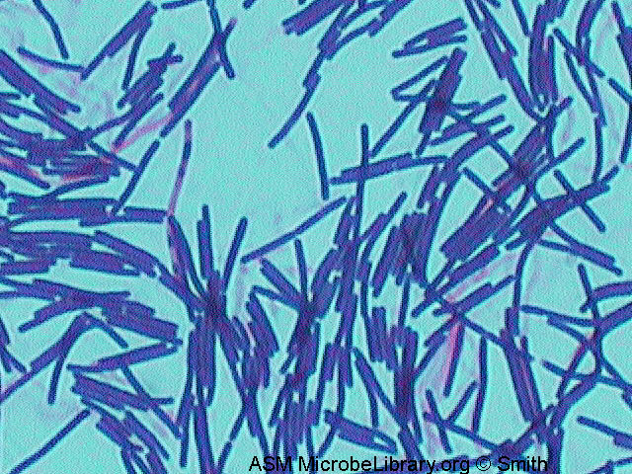
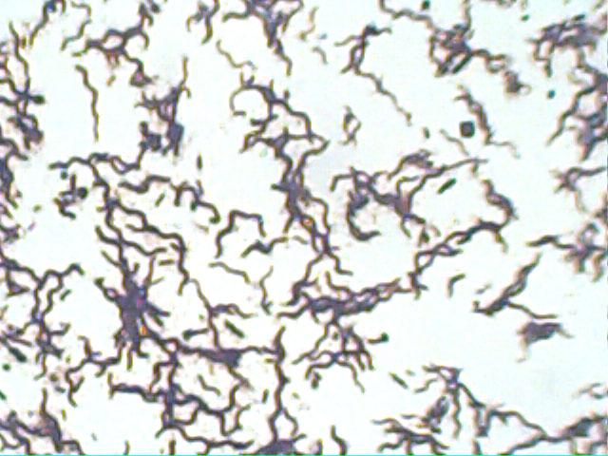
What shape?
bacillus
spirillum
coccus
coccus
bacillus
spirillum

Slide 6
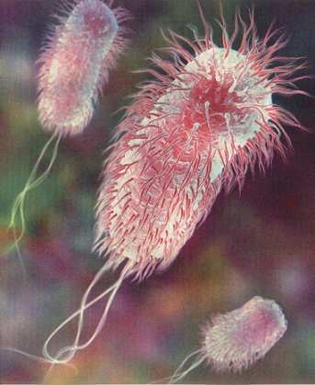
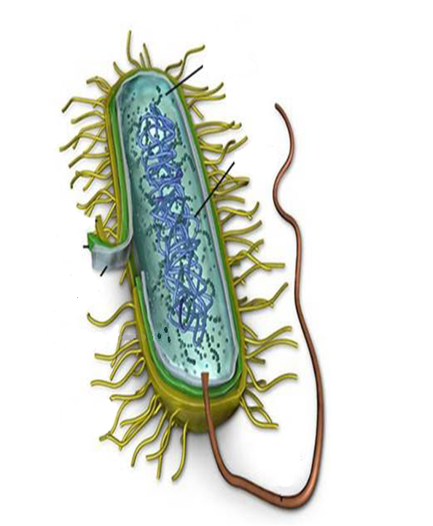
Cytoplasm
Genetic Material
Cell
Wall
Cell Membrane
Flagella
Example: E. coli

Slide 7
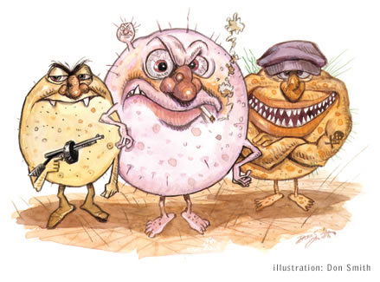
Causes Disease by:
1. Destroying cells of infected organisms by breaking the cells down for food.

Slide 8
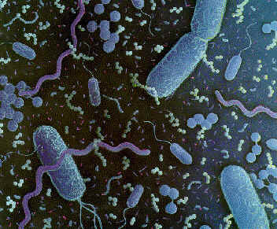
Releases toxins (poisons) which destroy cells of infected organism.
Must have access to new hosts to spread.

Slide 9
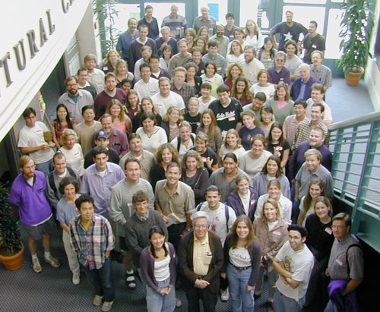
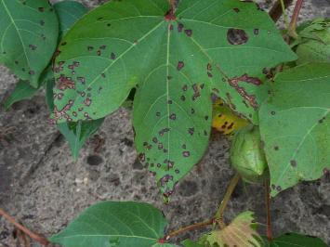
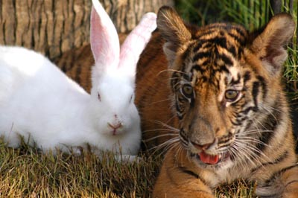
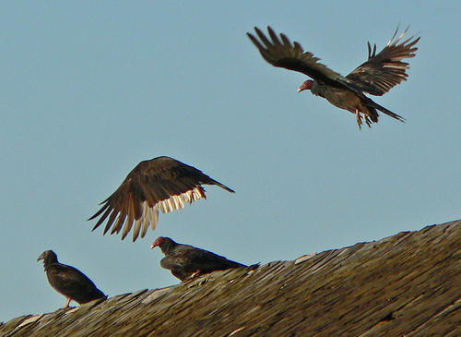
Different Hosts

Slide 10
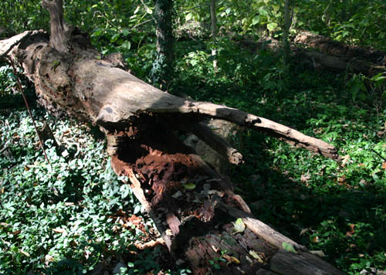
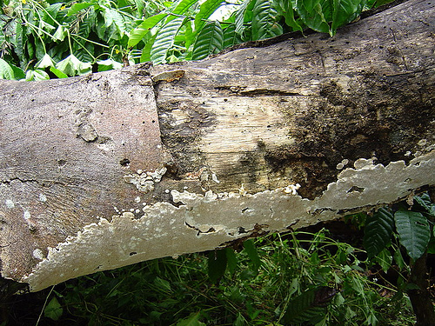
D. Importance:
1. Beneficial
a. breakdown dead matter to recycle nutrients into ecosystem - decomposers

Slide 11
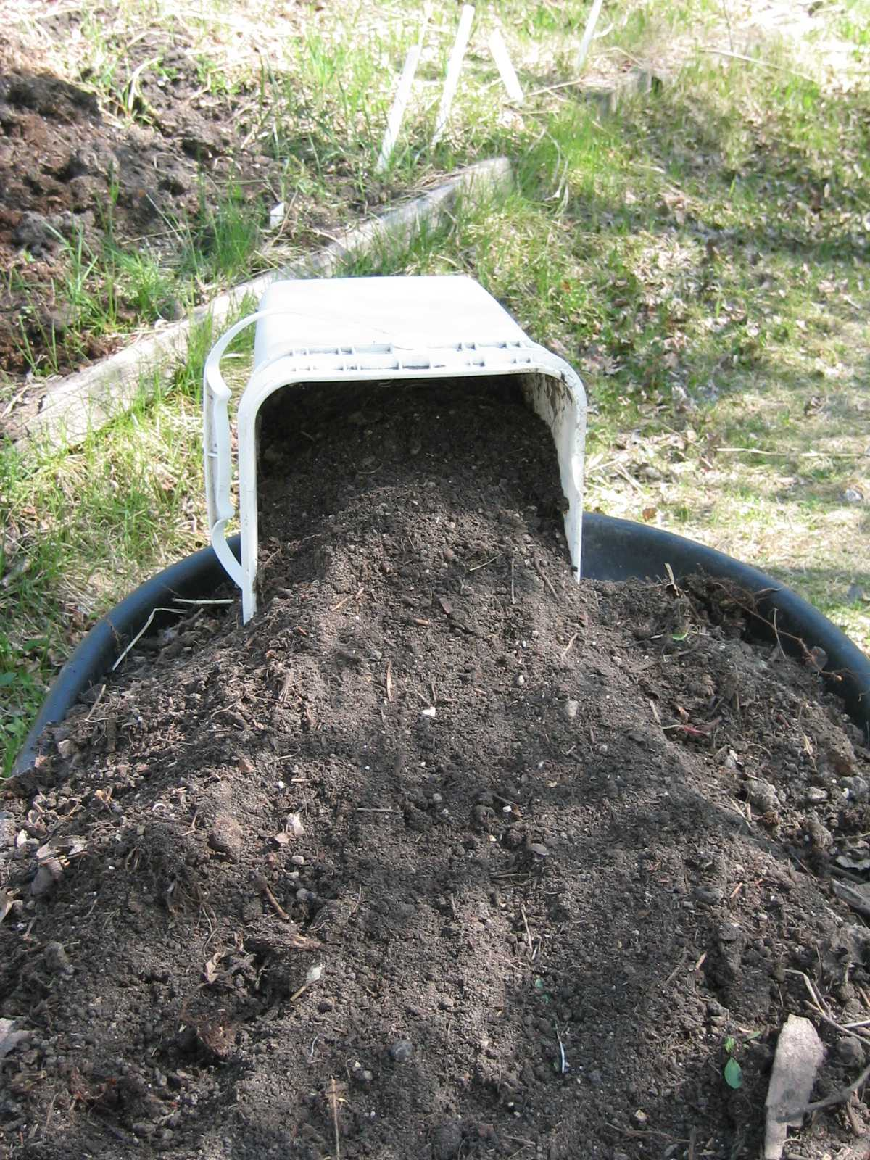
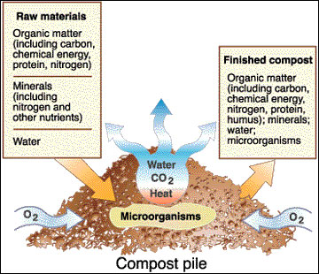
Example: Compost piles need microorganisms (ex. bacteria) to decompose (breakdown) matter.

Slide 12
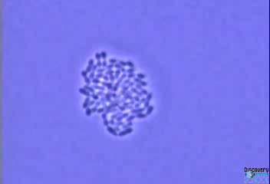
b. dairy industry - bacteria in 2:08 minute video
yogurt, sour cream and cheese

Slide 13
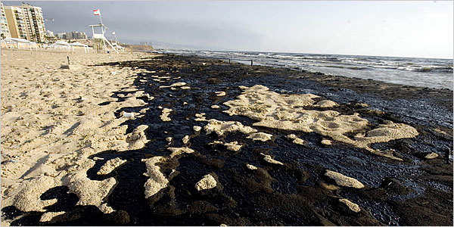
c. Oil spills - bacteria can digest small oil spills

Slide 14
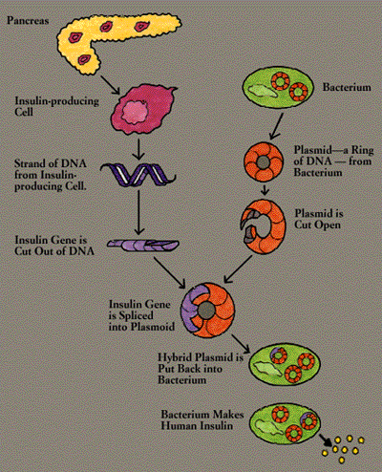
d. Genetic
engineering—
Recombinant/synthetic DNA (Ex: Insulin)

Slide 15
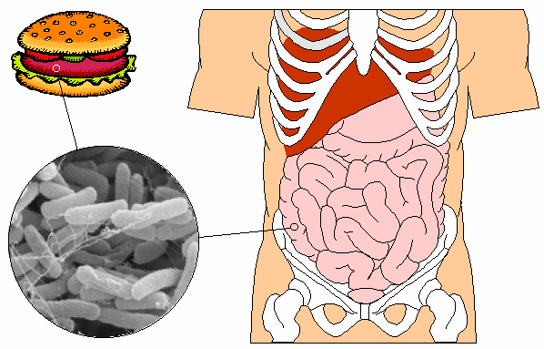
e. symbiotic relationship - E. coli and our
intestines-both organisms benefit
  Example: E. coli in intestines helps us digest food and make vitamins (such as Vitamin K and B-complex) In return, human intestines provide food and shelter for bacteria.
(This strain of E. coli is different from the E. coli strain that causes food poisoning.)

Slide 16
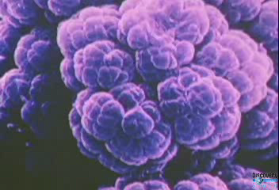
3:07 minute video

Slide 17
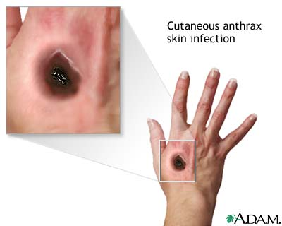
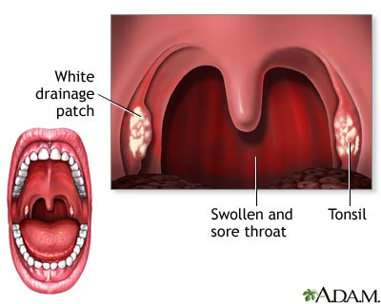
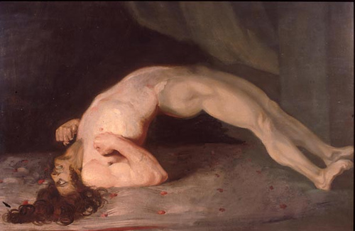
Harmful :
human diseases –
strep throat, tuberculosis,
tooth decay and bad
breath, anthrax, plague,
tetanus, food poisoning
Anthrax
Tetanus
Strep Throat

Slide 18
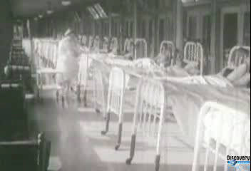
3:15 minute video

Slide 19
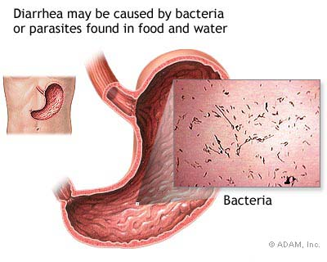
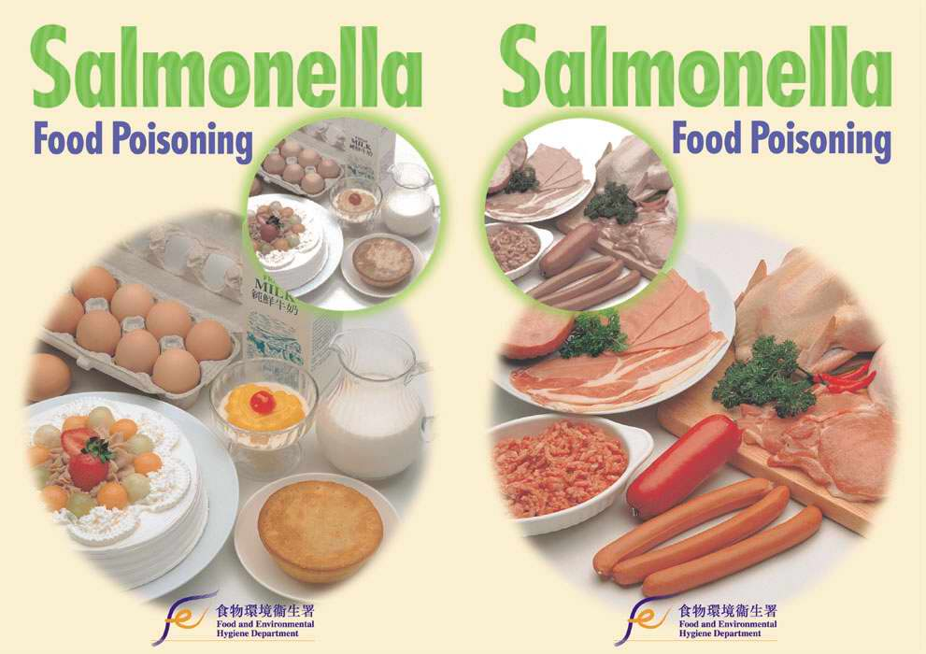
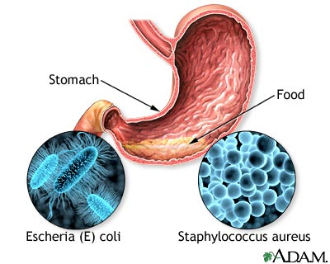
b. food spoilage and poisoning – caused by
Salmonella and Staphylococcus
c. Treated with antibiotics – Some bacteria are able
to survive in presence of antibiotics that kill
other bacteria – antibiotic resistant bacteria
Note: This is why doctors tell you to take the entire amount of medicine given even if you start to feel better because if not, bacteria will have the chance to evolve and become antibiotic resistant.

Slide 20
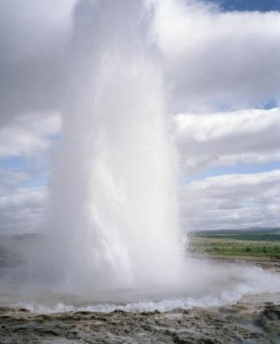
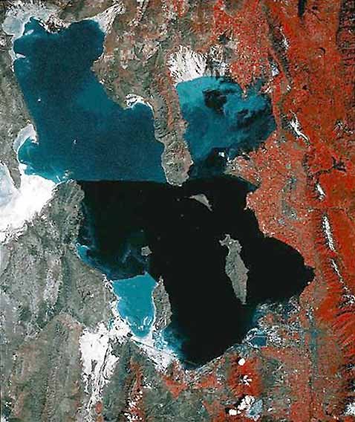
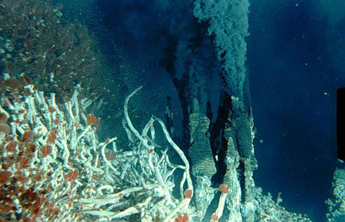
Salt Lake City
Kingdom Archaebacteria
First known prokaryotes-
  Archaebacteria (archae=ancient)
b. Live in very harsh environments
  (known as extremophiles)– high salt content, hot temperatures, acidic or alkaline environments
Hydrothermal vents
Geyser

Slide 21
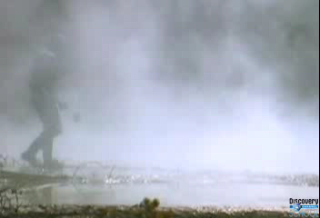
3:12 minute video

Slide 22
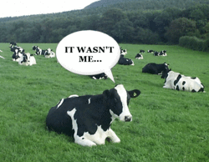
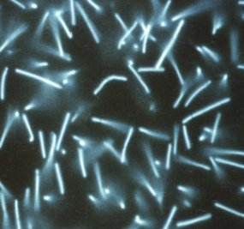
c. Live in intestines of
animals, especially
cows and other
grazing animals –
methanogens
Produce methane gas – greatly affects our atmosphere by combining with O₂ to make CO₂ for photosynthesis
d. Same size and
shape as Eubacteria,
but different
biochemical makeup
methanogenic archaebacteria

