Slide 1
Cellular Respiration

Slide 2
What is Cellular Respiration?
Everything your body does requires energy.
Humans and other animals get their energy from eating food and drinking water, however, your body needs to translate the food you eat to useable every at the cellular level.
Cheeseburger → Digestion → Glucose → Energy.

Slide 3
Cellular Respiration
Cellular Respiration is a process by which cells gain energy from organic molecules.

Slide 4
Cellular Respiration
C₆H₁₂O₆ + 6O₂ → 6CO₂ + 6H₂O + ATP
Sugar + Oxygen → Carbon Dioxide + Water + ENERGY

Slide 5
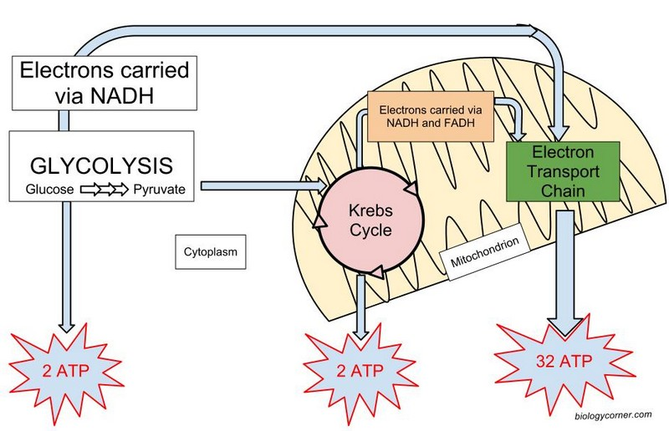
Cellular Respiration

Slide 6
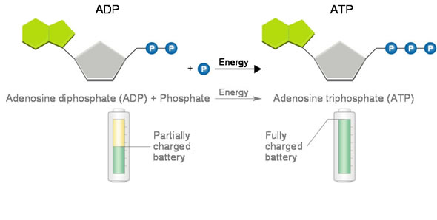
Cellular Respiration
Major Players in Cellular Respiration:
Adenosine triphosphate (ATP) – Energy source for all cells. Considered the “energy currency” of the cell. Releases large amounts of energy when converted to Adenosine diphosphate (ADP).

Slide 7
The Truth about ATP
The enormous amount of activity that occurs inside each of the approximately one hundred trillion human cells is shown by the fact that at any instant each cell contains about one billion ATP molecules.
This amount is sufficient for that cell’s needs for only a few minutes and must be rapidly recycled. Given a hundred trillion cells in the average male, about 10²³ or one sextillion ATP molecules normally exist in the body. For each ATP “the terminal phosphate is added and removed 3 times each minute” (Kornberg, 1989, p. 65).

Slide 8
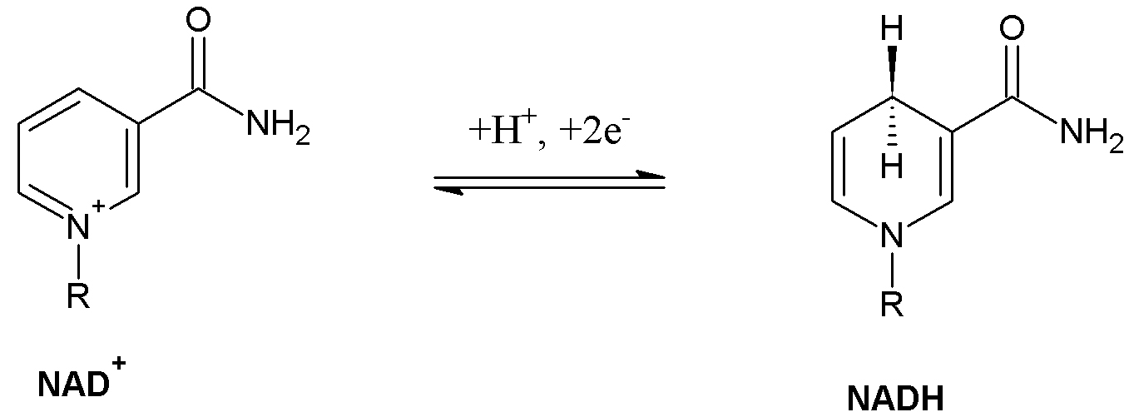
CELLULAR respiration
NAD+/NADH
FAD/FADH₂
Energy Intermediates. Used at the last stage of Cellular Respiration to create ATP.
Think of these like “energy taxis”- the passengers are electrons which are released later

Slide 9
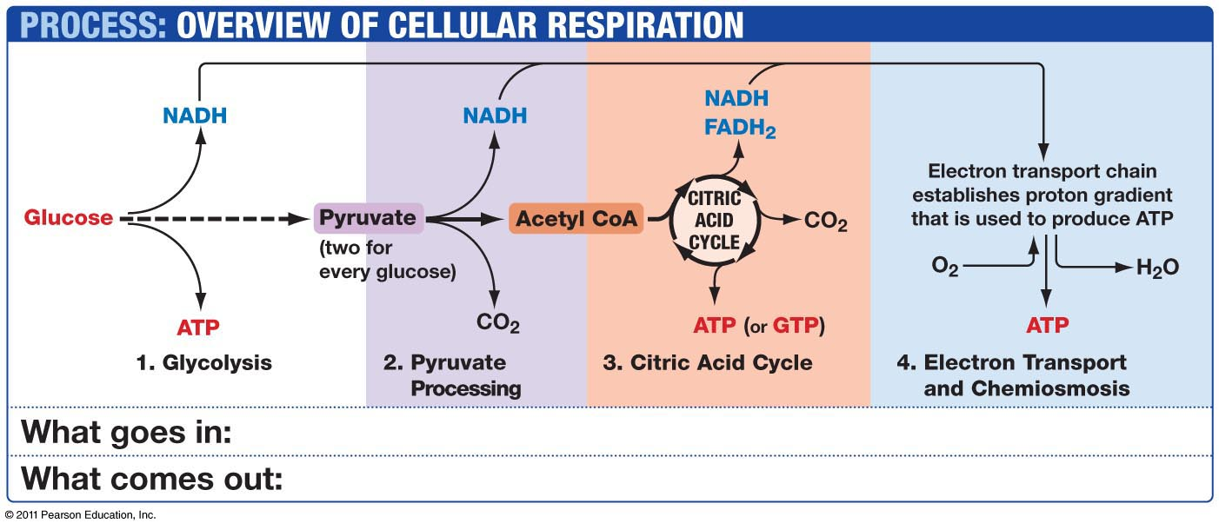
Cellular Respiration

Slide 10
Cellular Respiration
Cellular respiration can occur in 2 ways:
Aerobic Respiration – requires oxygen but yields a lot of energy.
Anaerobic Respiration – Occurs when oxygen is not present. Produces little energy.
Both Aerobic and Anaerobic respiration have the first step, Glycolysis, in common.

Slide 11
Aerobic Cellular Respiration
Aerobic Cellular Respiration has 3 steps:
Glycolysis
Kreb’s Cycle (Citric Acid Cycle)
Oxidative Phosphorylation.

Slide 12
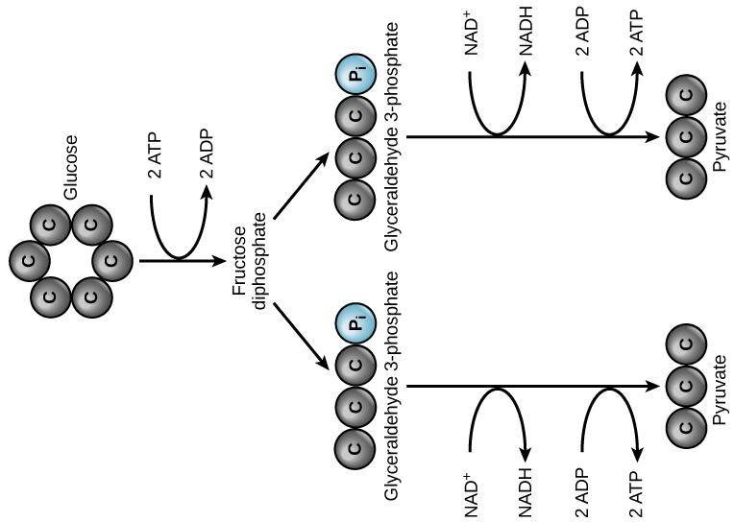
Glycolysis

Slide 13
Glycolysis
Glycolysis is the breaking down of glucose from a 6 carbon molecule into two pyruvate molecules (3 carbons each).
This produces a net gain of two ATP and two NADH molecules. Glycolysis occurs in the Cytoplasm of a cell.

Slide 14
Pyruvate Oxidation: First Pyruvate is broken down into an Acetyl group (two Carbons) called Acetyl COA
which gives off CO₂ and one NADH molecule.

Slide 15
Kreb’s Cycle
Aetyl COA (2 carbon) Enters the Krebs cycle and joins with Acetic acid (4 Carbon)to create Cytric Actic (6 Carbon)
Each Acetyl group (2C) is broken down to:
two CO₂ molecules
One ATP
Three NADH and one FADH₂

Slide 16
6 Carbon Citric Acid is broken down into 5Carbon Alpha-Ketogluterate which charges an NAD+ to NADH and releases CO2

Slide 17
Alpha-Ketogluterate is broken down in 2 steps creating a 4Carbon molecule called Acetic acid. During this process:
2 NAD+ →NADH
1 ADP → 1 ATP
1 FAD →FADH2

Slide 18
CELLULAR respiration
NAD+/NADH
FAD/FADH₂
Energy Intermediates. Used at the last stage of Cellular Respiration to create ATP. Think of them as ENERGY TAXIs

Slide 19
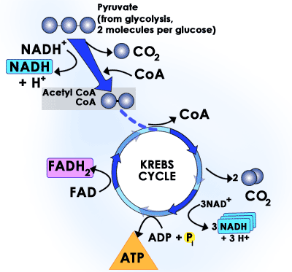
Kreb’s Cycle (Citric acid cycle)

Slide 20
Oxidative phosphorylation
Oxidative Phosphorylation consists of two parts, the Electron Transport Chain (ETC) and ATP synthase. NADH and FADH₂ made in the previous stages contain high energy electrons that can be transferred to other molecules. When removed, these electrons release energy which is used to make approx. 34 ATP.
Occurs in the Mitochondria.

Slide 21
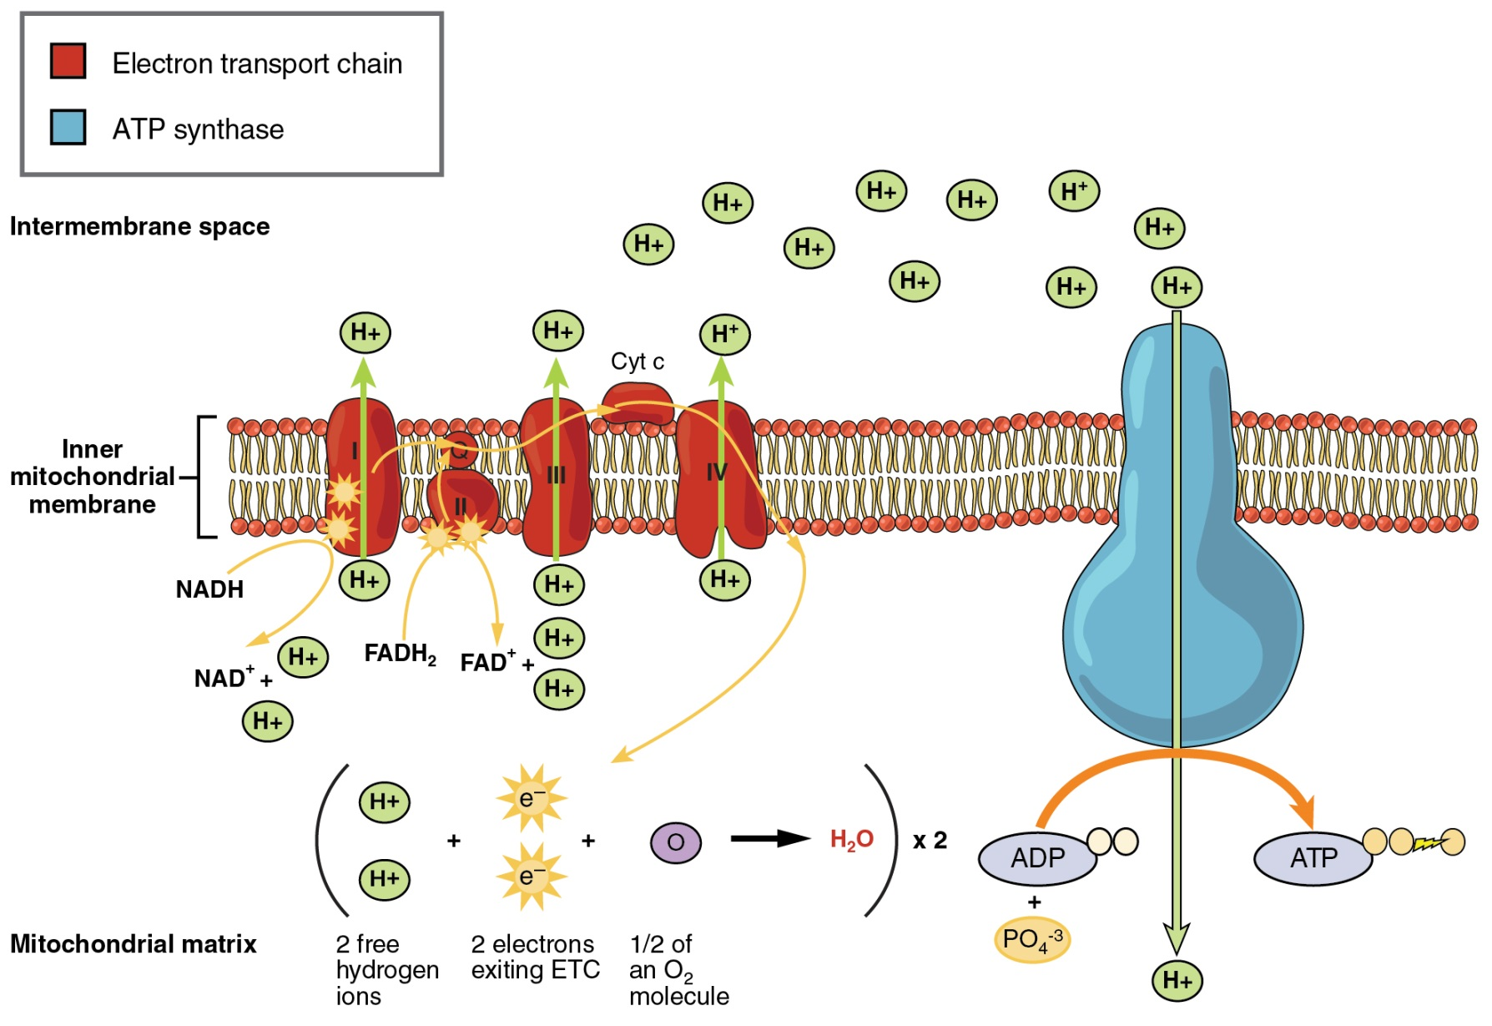
Oxidative phosphorylation

