Slide 1
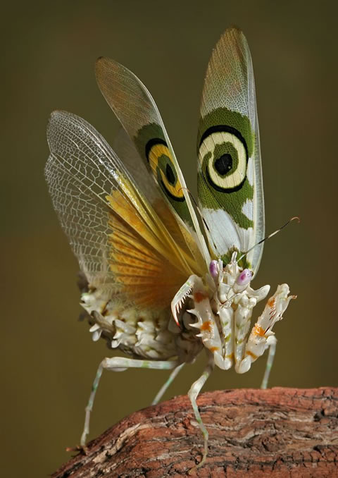
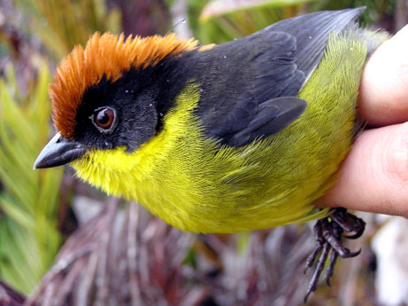
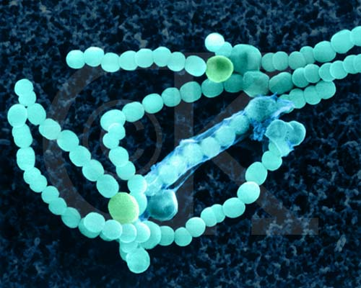
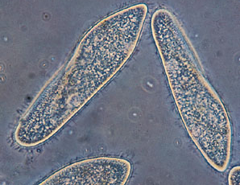
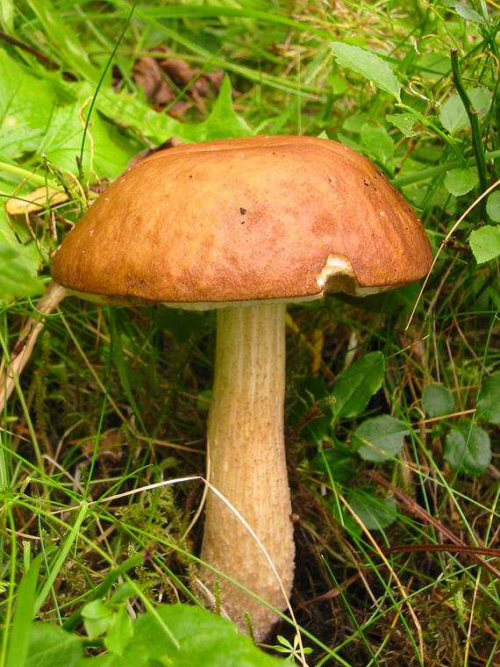
Classification

Slide 2
TAXONOMY
A system of organization or classification
To classify is to put objects or ideas into groups on the basis of similarity
Why is classification important?
-aids in identification of organisms
-provides a basis for recognizing natural grouping of things
-avoid confusion
-aids in communication
-gain info about unknown organisms
-provides a basis for comparison

Slide 3
HISTORY OF TAXONOMY
Aristotle (a Greek philosopher) classified all organisms as either plants or animals
He classified each animal according to where it lived
on land, in water, or in the air
ie. Ants would be related to mice
Bats would be related to mosquitoes
He classified each plant as:
an herb, a shrub, or a tree

Slide 4
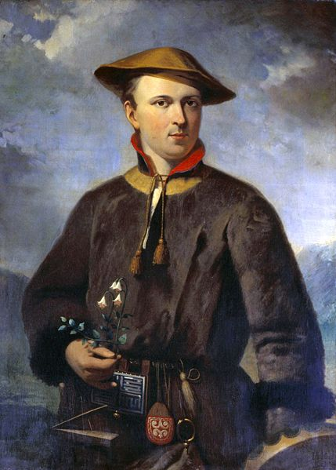
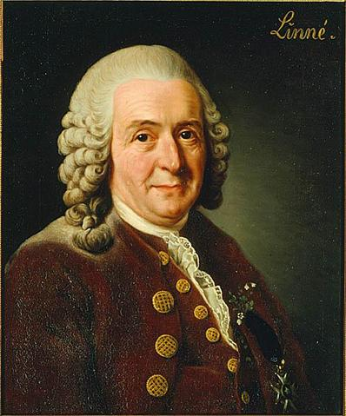
Carolus Linnaeus

Slide 5
Binomial Nomenclature
Carolus Linnaeus grouped together organisms that most closely resembled each other
Each species was identified by two names called the binomial nomenclature method. The first name is genus (capitalized), followed by species (not capitalized). Both words are in italics and underlined.
Ex. Polyura eudamippus
Linnaeus grouped all organisms from a broad to a more specific description.

Slide 6
LEVELS OF CLASSIFICATION
If an alien from outer space asked you where you lived, how would you answer?
from broad to specific
Universe
Galaxy
Solar system
Planet
Hemisphere
Country
Province
City
Street Address

Slide 7
LEVELS OF CLASSIFICATION
Domain
Kingdom
Phylum (Animals)/Division (plants)
Class
Order
Family
Genus
species
Take 5 minutes and make your own mnemonic
Did King Philip (David) climb over five green sticks?

