Slide 1
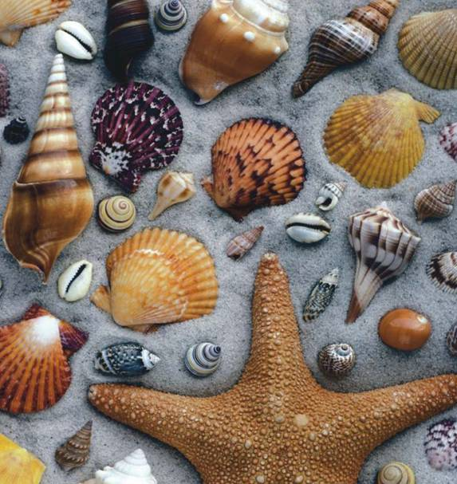
Domains
Notes:
Photo credit: ©Gary Randall/Visuals Unlimited

Slide 2
The Three-Domain System
The Three-Domain System
Modern classification is a rapidly changing science!
Molecular analyses have given rise to a new taxonomic category that is now recognized by many scientists.
The domain is a more inclusive category than any other—larger than a kingdom.

Slide 3
The Three-Domain System
The three domains are:
Archaea, = kingdom Archaebacteria.
Bacteria, = kingdom Eubacteria.
Eukarya, = protists, fungi, plants, and animals.

Slide 4
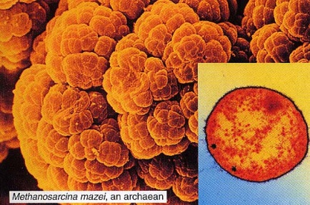
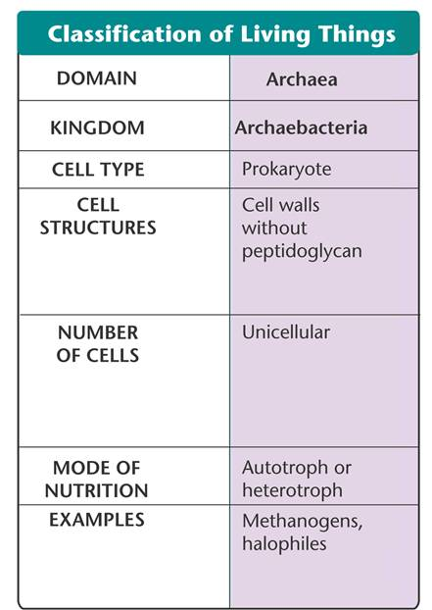
Domain Archaea
The domain Archaea corresponds to the kingdom Archaebacteria.
Unicellular prokaryotes
live in extreme environments (most like early earth)
cell walls are simpler, and their cell membranes contain unusual lipids not found in any other organism.

Slide 5
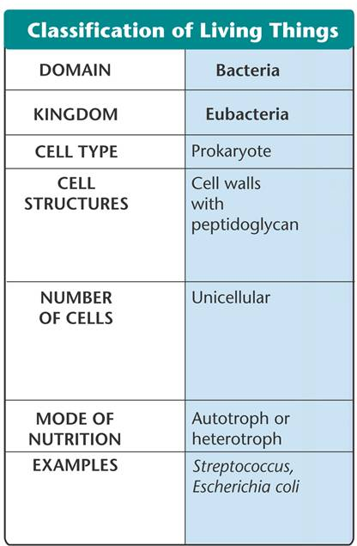
Domain Bacteria
The domain Bacteria corresponds to the kingdom Eubacteria.
unicellular prokaryotes.
cells have thick, rigid cell walls that surround a cell membrane.
First organisms to photosynthesize
Cyanobacteria

Slide 6
The Tree of Life Evolves
The Tree of Life Evolves
Linnaeus (more on him later) classified organisms into two kingdoms— animals and plants.
The only known differences among living things were the fundamental traits that separated animals from plants. We now use many different kinds of evidence including DNA, proteins, embryology, etc.

Slide 7
The Tree of Life Evolves
The six-kingdom system of classification includes:
Eubacteria
Archaebacteria
Protista
Fungi
Plantae
Animalia

Slide 8
The Tree of Life Evolves
Changing Number of Kingdoms
Introduced
Names of Kingdoms
1700’s
Plantae
Animalia
Late 1800’s
Protista
Plantae
Animalia
1950’s
Monera
Protista
Fungi
Plantae
Animalia
1990’s
Eubacteria
Archae-bacteria
Protista
Fungi
Plantae
Animalia
Notes:
This diagram shows some of the ways organisms have been classified into kingdoms over the years. The six-kingdom system includes the following kingdoms: Eubacteria, Archaebacteria, Protista, Fungi, Plantae, and Animalia.

Slide 9
Domain Eukarya
Domain Eukarya
The domain Eukarya consists of organisms that have a nucleus (eukaryotes)
This domain is organized into four kingdoms:
Protista
Fungi
Plantae
Animalia
**NOTE: There is one group of organisms- the Protists that scientists are having trouble classifying. We will look at examples of these in class.

Slide 10
Please Copy and Complete:
As we go through this unit, you will find it helpful to summarize your learning in chart form so all of your information is on one page. (you may use the internet to help find more characteristics, if needed)
Domains
 | Bacteria | Archaea | Eukarya
Characteristics

