Slide 1
Evolution
Mutations, gene flow, genetic drift, and selective breeding

Slide 2
Mutations
Mutation is a change in DNA, the hereditary material of life. An organism's DNA affects how it looks, how it behaves, and its physiology — all aspects of its life. So a change in an organism's DNA can cause changes in all aspects of its life.
Mutations are random
Mutations can be beneficial, neutral, or harmful for the organism, but mutations do not "try" to supply what the organism "needs." In this respect, mutations are random-whether a particular mutation happens or not is unrelated to how useful that mutation would be.
Not all mutations matter to evolution
Since all cells in our body contain DNA, there are lots of places for mutations to occur; however, not all mutations matter for evolution. Somatic mutations occur in non-reproductive cells and won't be passed onto offspring.

Slide 3
Causes of Mutation
Mutations happen for a couple of reasons.
DNA fails to copy accurately
Most of the mutations that we think matter to evolution are "naturally-occurring." For example, when a cell divides, it makes a copy of its DNA — and sometimes the copy is not quite perfect. That small difference from the original DNA sequence is a mutation.
External influences can create mutations
Mutations can also be caused by exposure to specific chemicals or radiation. These agents cause the DNA to break down. This is not necessarily unnatural — even in the most isolated and pristine environments, DNA breaks down. Nevertheless, when the cell repairs the DNA, it might not do a perfect job of the repair. So the cell would end up with DNA slightly different than the original DNA and hence, a mutation.

Slide 4
Gene flow
Gene flow — also called migration — is any movement of individuals, and/or the genetic material they carry, from one population to another. Gene flow includes lots of different kinds of events, such as pollen being blown to a new destination or people moving to new cities or countries.
If gene versions are carried to a population where those gene versions previously did not exist, gene flow can be a very important source of genetic variation.

Slide 5
Genetic drift
Genetic drift — along with natural selection, mutation, and migration — is one of the basic mechanisms of evolution.
In each generation, some individuals may, just by chance, leave behind a few more descendants (and genes, of course!) than other individuals. The genes of the next generation will be the genes of the "lucky" individuals, not necessarily the healthier or "better" individuals. That, in a nutshell, is genetic drift. It happens to ALL populations — there's no avoiding the whims of chance.

Slide 6
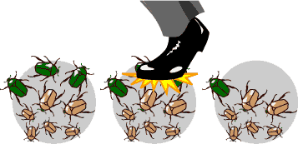
Genetic drift
Genetic drift affects the genetic makeup of the population but, unlike natural selection, through an entirely random process. So although genetic drift is a mechanism of evolution, it doesn't work to produce adaptations.

Slide 7
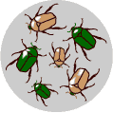
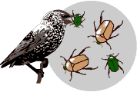
Natural Selection
There is variation in traits.
For example, some beetles are green and some are brown.
There is differential reproduction.
Since the environment can't support unlimited population growth, not all individuals get to reproduce to their full potential. In this example, green beetles tend to get eaten by birds and survive to reproduce less often than brown beetles do.

Slide 8
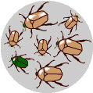
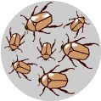
Natural Selection
There is heredity.
The surviving brown beetles have brown baby beetles because this trait has a genetic basis.
End result:
The more advantageous trait, brown coloration, which allows the beetle to have more offspring, becomes more common in the population. If this process continues, eventually, all individuals in the population will be brown.

Slide 9
Artificial Selection / Selective Breeding
Long before Darwin, farmers and breeders were using the idea of selection to cause major changes in the features of their plants and animals over the course of decades. Farmers and breeders allowed only the plants and animals with desirable characteristics to reproduce, causing the evolution of farm stock.
This process is called artificial selection/selective breeding because people (instead of nature) select which organisms get to reproduce.

Slide 10
Artificial Selection / Selective Breeding
Can you think of a common example of selective breeding?

