Slide 1
Human evolution!

Slide 2
The human evolution story begins in Africa about 6 million years ago.
Over 6 million years our ape-like ancestors evolved into upright walking, tool using and cultural modern humans, spreading out across the globe. There have been many different hominid species in the past, but only one – Homo sapiens sapiens – has been ultimately successful.
We are the only surviving branch of a diverse family tree.

Slide 3
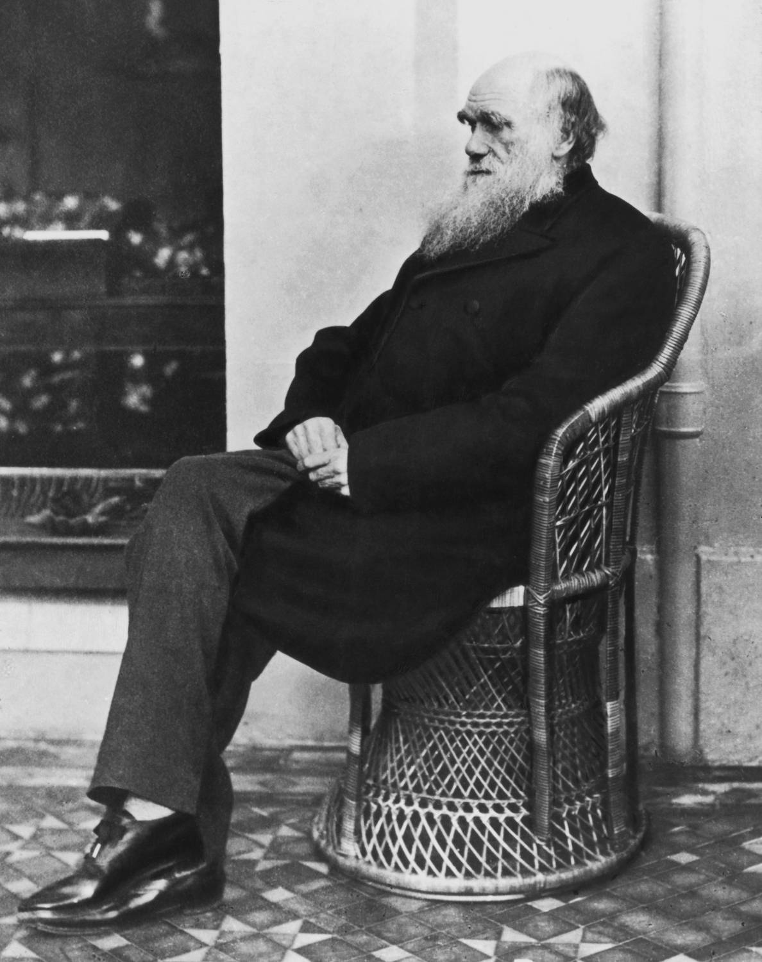
In 1871, Charles Darwin proposed in his book “The Descent of Man” that humans evolved in Africa and shared a common ancestor with great apes.
This showed remarkable foresight as at that time there were no early human fossils and no DNA evidence.

Slide 4
How do scientists study human evolution?
Humans evolved from ape-like creatures
THEORY
Humans and apes share many biological features
2. There should be fossils with human and ape-like features
Humans and apes have a common ancestor
1. Humans and apes should share a high percentage of DNA
Observation
HYPOTHESIS
Prediction
Gather evidence,
test with experiments
Measure DNA differences between humans and apes.
Examine fossils from several million years ago.
Notes:
In the case of human evolution, Charles Darwin noted that humans and apes share many biological features (click 1). He hypothesized that (click 2) humans and apes share a common ancestor. If this hypothesis is true then (click 3) humans and apes should share a high percentage of their DNA, and (click 4) there should be fossils with humans and ape-like features. Darwin wasn’t able to gather this sort of evidence to test his hypothesis in his time, but many studies since then have tested these predictions (click 5). Both DNA and fossil evidence support the hypothesis of humans and apes sharing a common ancestor.

Slide 5
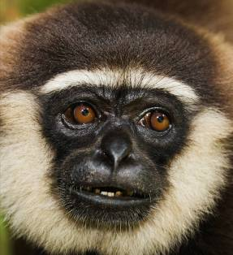
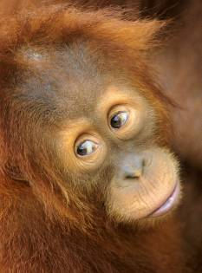
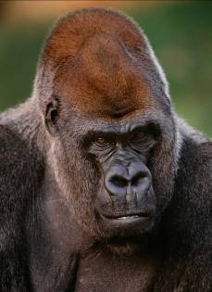
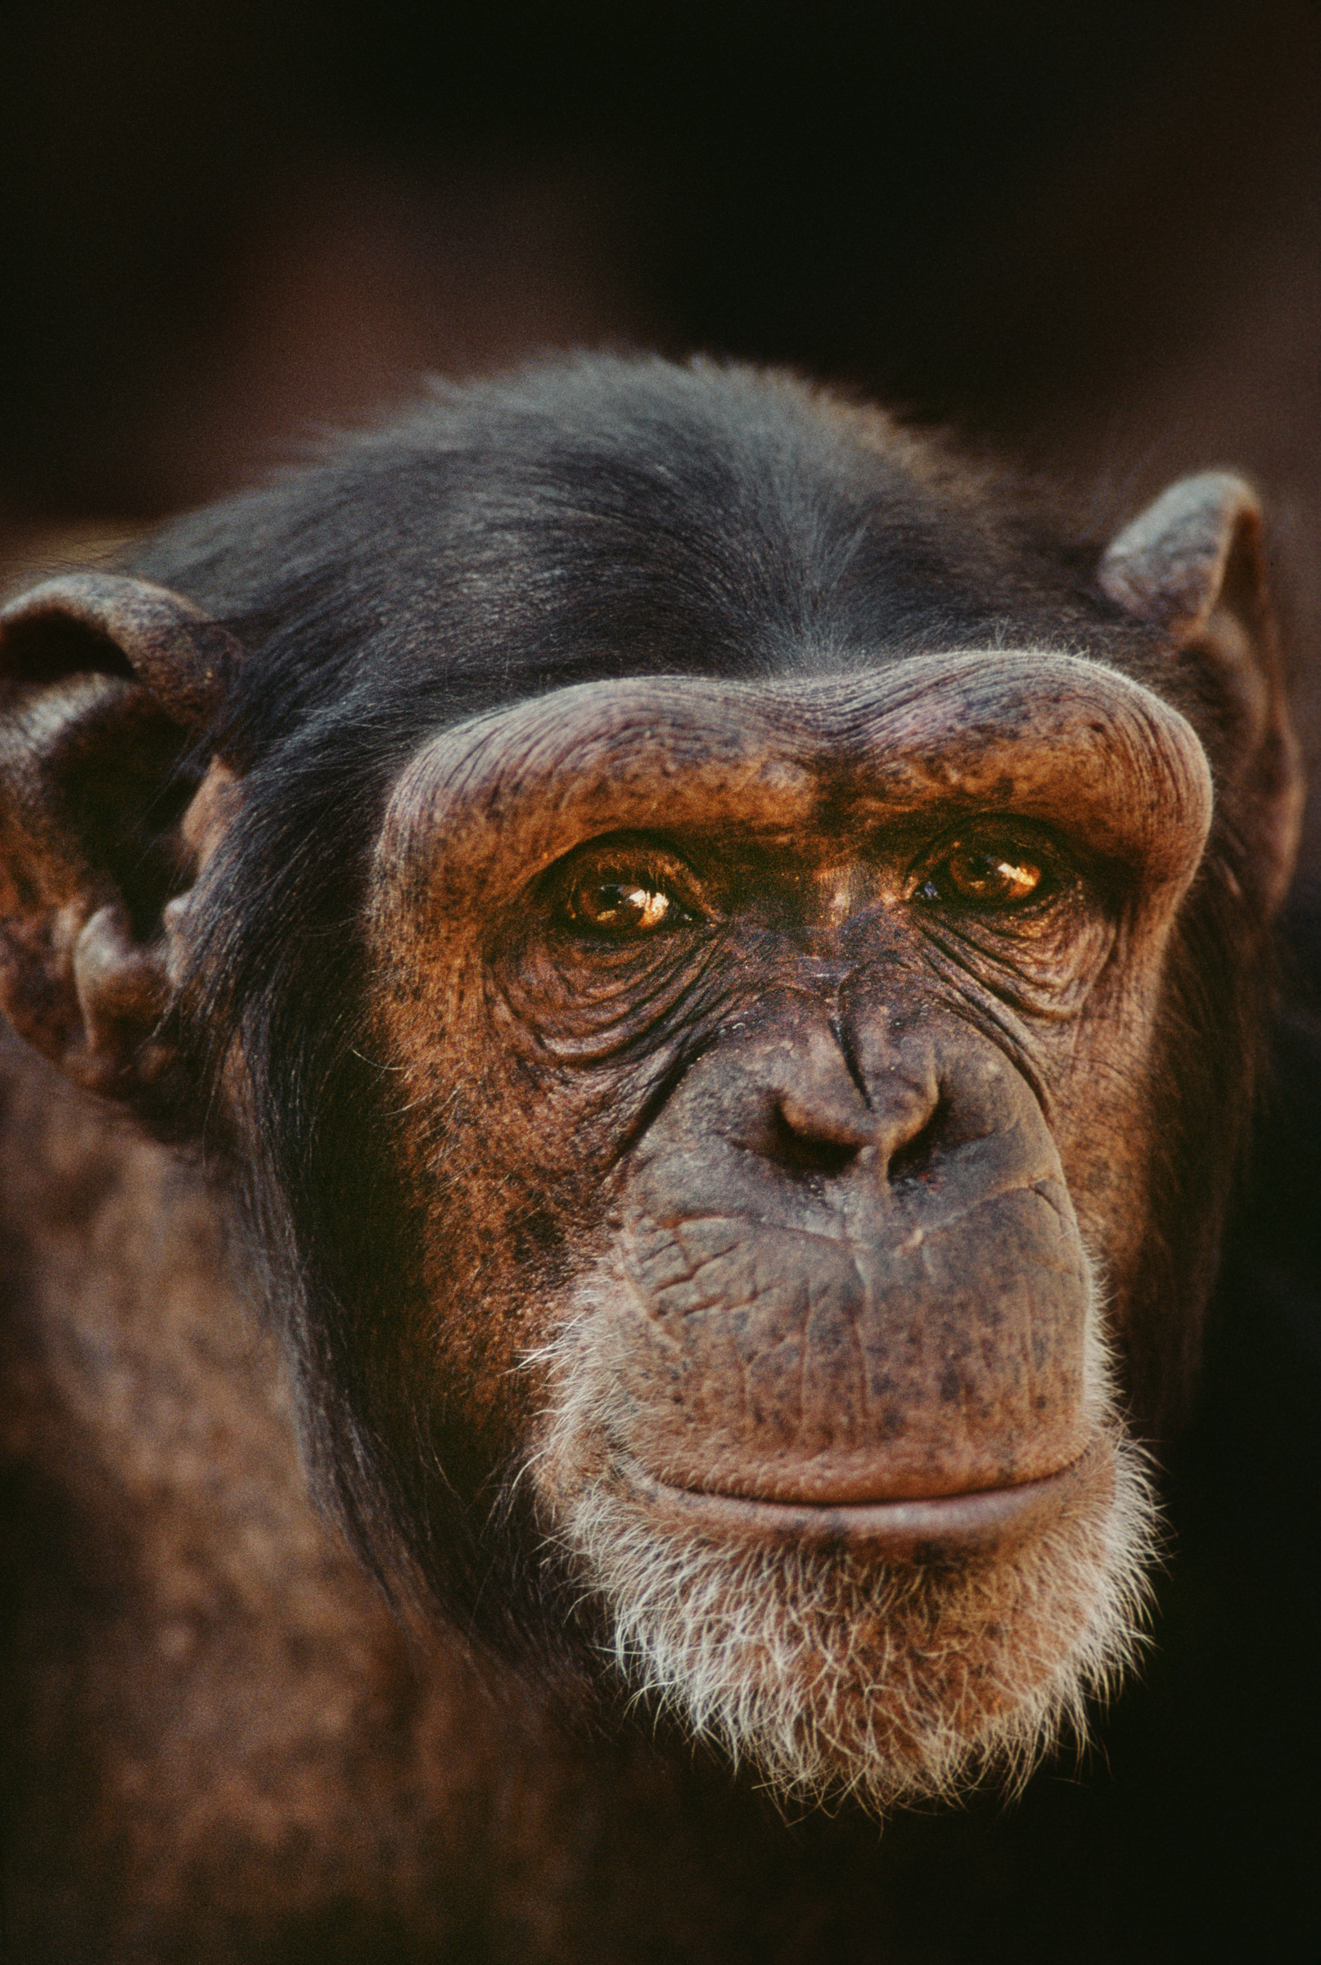
Old-World monkeys
Gibbon
Orangutan
Gorilla
Chimpanzee
Human
We now know, from genetic and fossil evidence, that our closest relative is the chimpanzee.
This does not mean we evolved from chimpanzees, it means that we share a common ancestor.

Slide 6
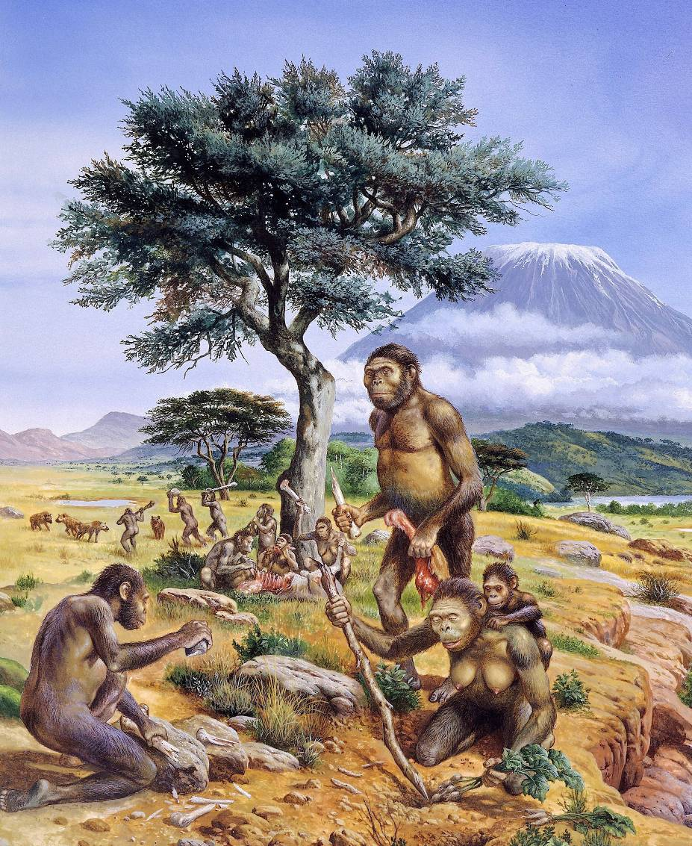
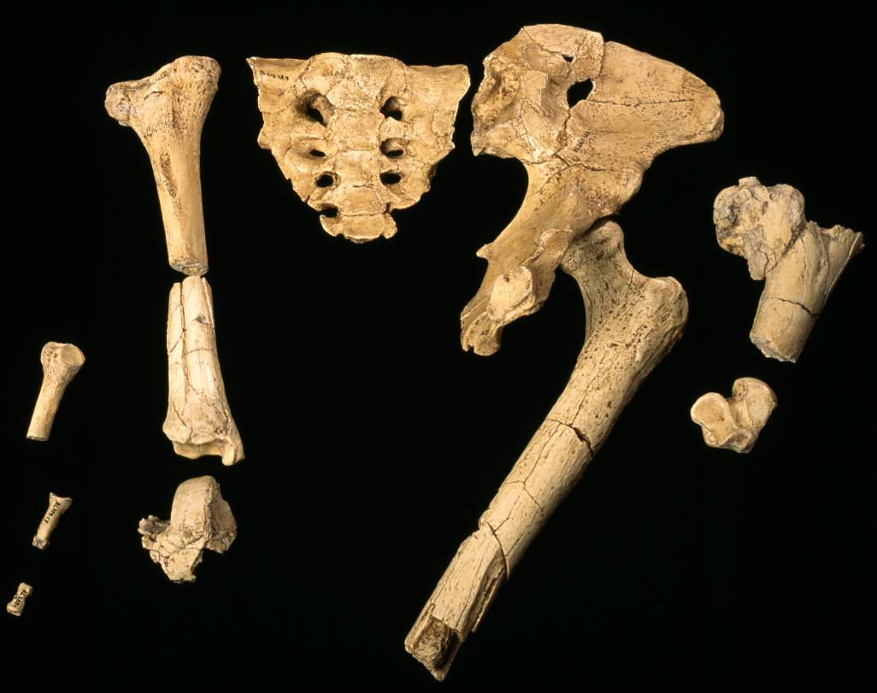
Our earliest ancestors lived in Africa
The earliest human-like fossils have been found in Africa and date back to 4-8 million years ago. They show that our earliest ancestors walked upright, but had much smaller brains and did not yet use sophisticated tools or use fire.

Slide 7
Hominids
Many different human-like species existed over the 4-8 million years since our lineage split from apes – collectively, we call these species hominids.
Some of these species would have lived at the same time, and not all of them are the direct ancestors of modern humans.
We don’t know the exact progression from species to species that led to modern humans. There are many different ideas, and as new fossils are discovered the gaps become filled and the picture becomes clearer.

Slide 8
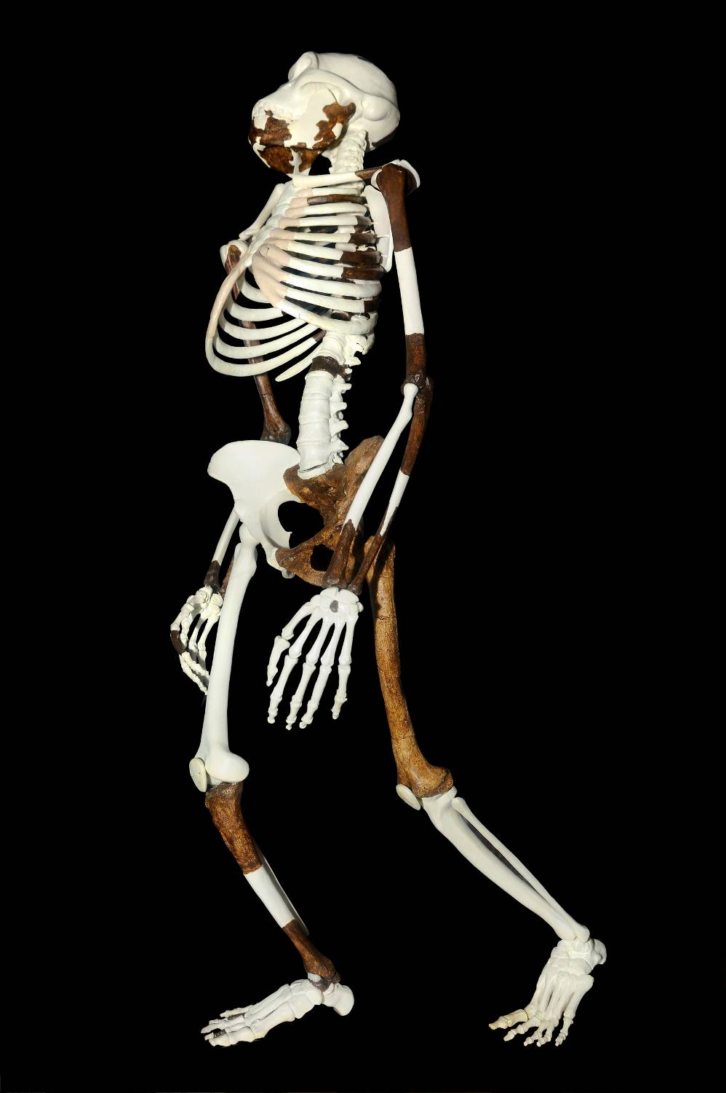
Australopithecus - an ape who walked on two legs
The earliest genus of hominids is called Australopithecus. This means “southern apes”
They were dubbed as southern apes because they were found in South Africa.
However there have been remains found in Eastern Africa as well.

Slide 9
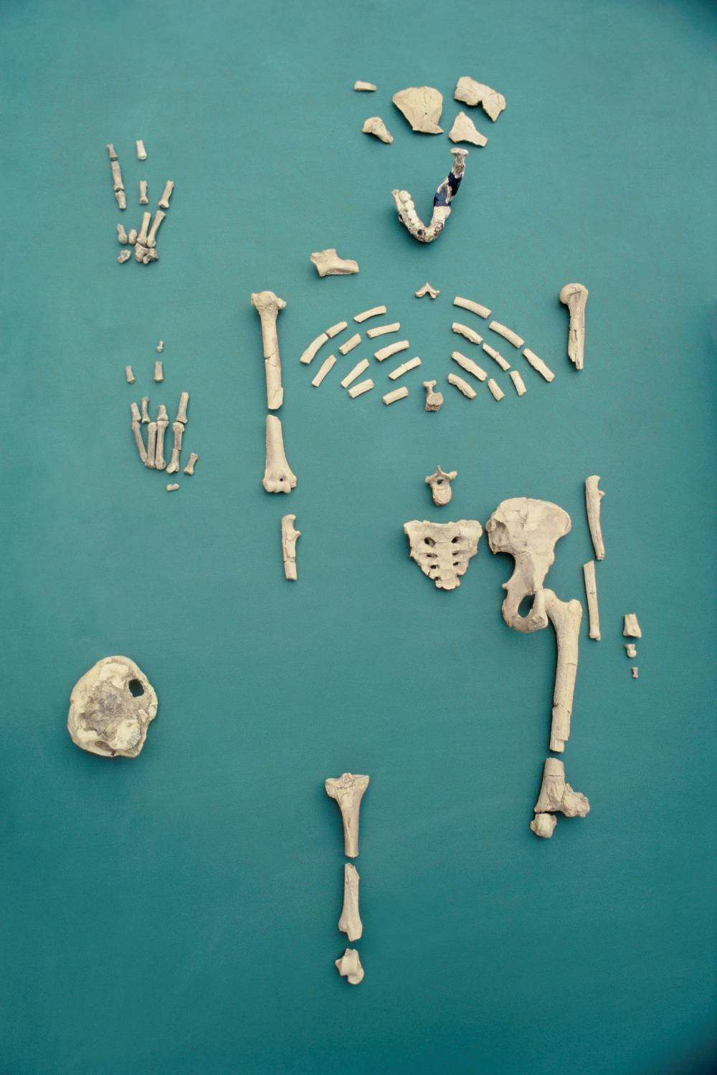
Australopithecus afarensis
The oldest skeleton unearthed to date was found in eastern Africa in 1974. This fossil is between 3 million-3.5 million years old. The shape of the pelvic bone indicates that the remains are those of a female.
Therefore, scientists have nicknamed her Lucy.
She stood around 1.1 metres (3.5 feet) tall and she walked upright on two legs, although she probably had a less graceful gait than us, since she walked with her legs bent.
Cranial capacity = 380 - 450 cm^3. less than 1/3 that of modern humans.
This discovery confirmed that bipedalism evolved very early in our evolutionary history.
Bipedalism= walking on two legs.

Slide 10
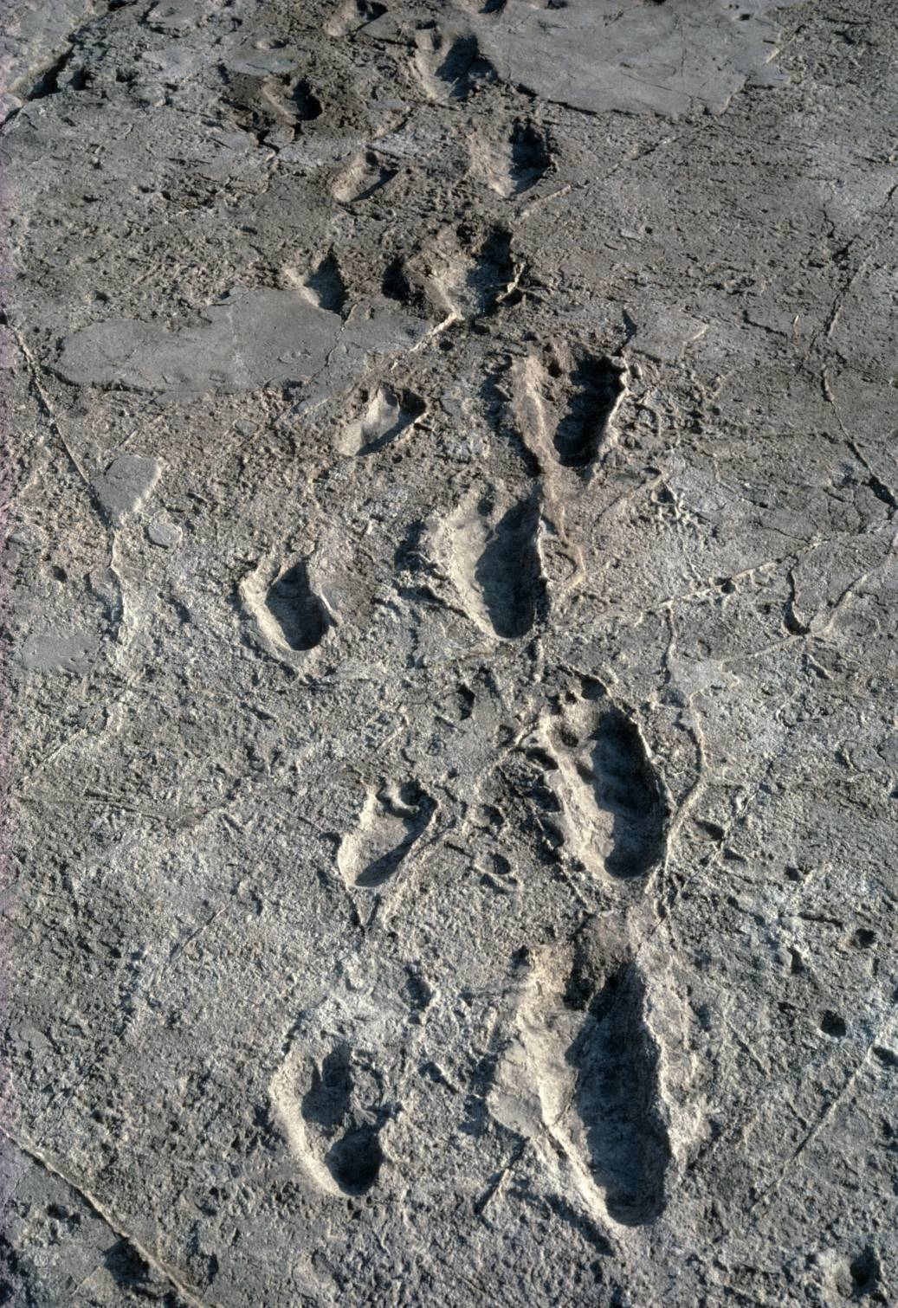
A few years later a set of footprints were discovered in hardened ash in Tanzania. These footprints date to 3-4 million years ago and were probably also made by Australopithecines. The creature that made these footprints undoubtedly walked upright further confirming that our ancestors were bipedal several million years ago. More recently discovered fossils dating back 5-6 million years also show signs of being bipedal.
The shift to bipedalism was a highly significant event in our history as it freed the hands to use tools.

Slide 11
Australopithecus Africanus
The next oldest species of australopithecines, Australopithecus Africanus lived 2.2 million to 3 million years ago. The firsts fossils of this species were found in South Africa. A. Africanus was slightly taller and heavier than A. Afarensis. It’s cranial capacity was slightly larger as well (430-550 cm^3)

Slide 12
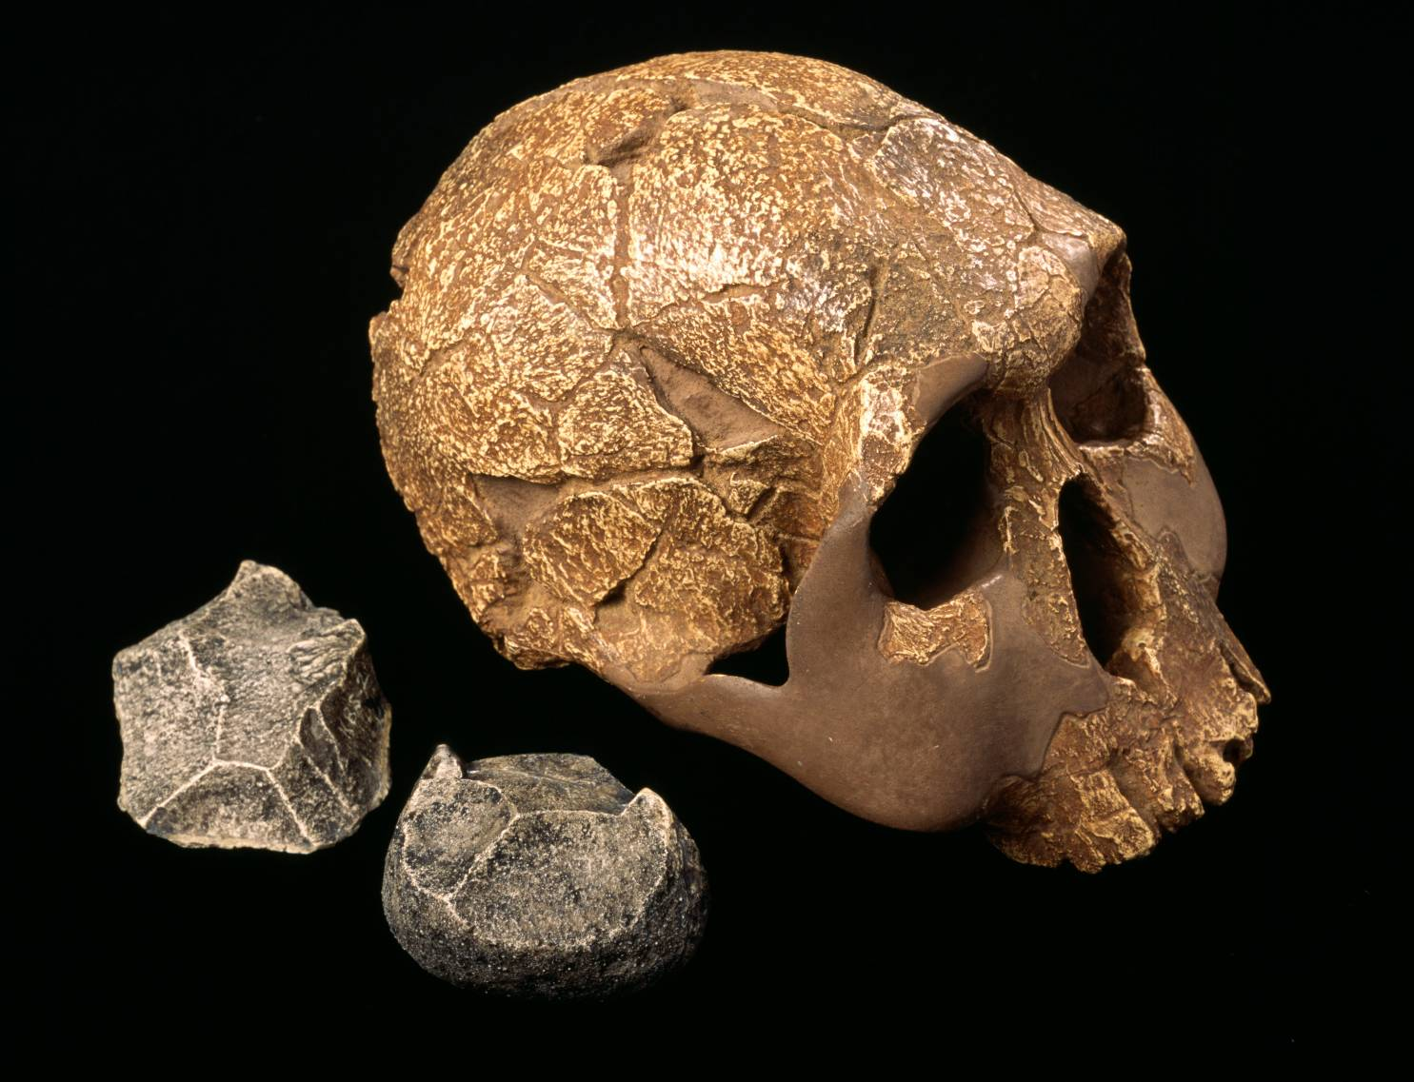
Homo habilis
In the 1960’s, a hominid skull was found that had a relatively large brain case. It was the first fossil to be found of such an early hominid species, with the cranial capacity of 600-800 cm^3.
These remains were found along with stone tools that were presumably made and used by the hominids.
When it was discovered that this new species used tools, they were given the name Homo Habilis which means Handy Human.
Finding some tool marks on animal bones near the hominid fossils indicated that H. Habilis ate meat.
These fossils are about 1.6-2 million years old.

Slide 13
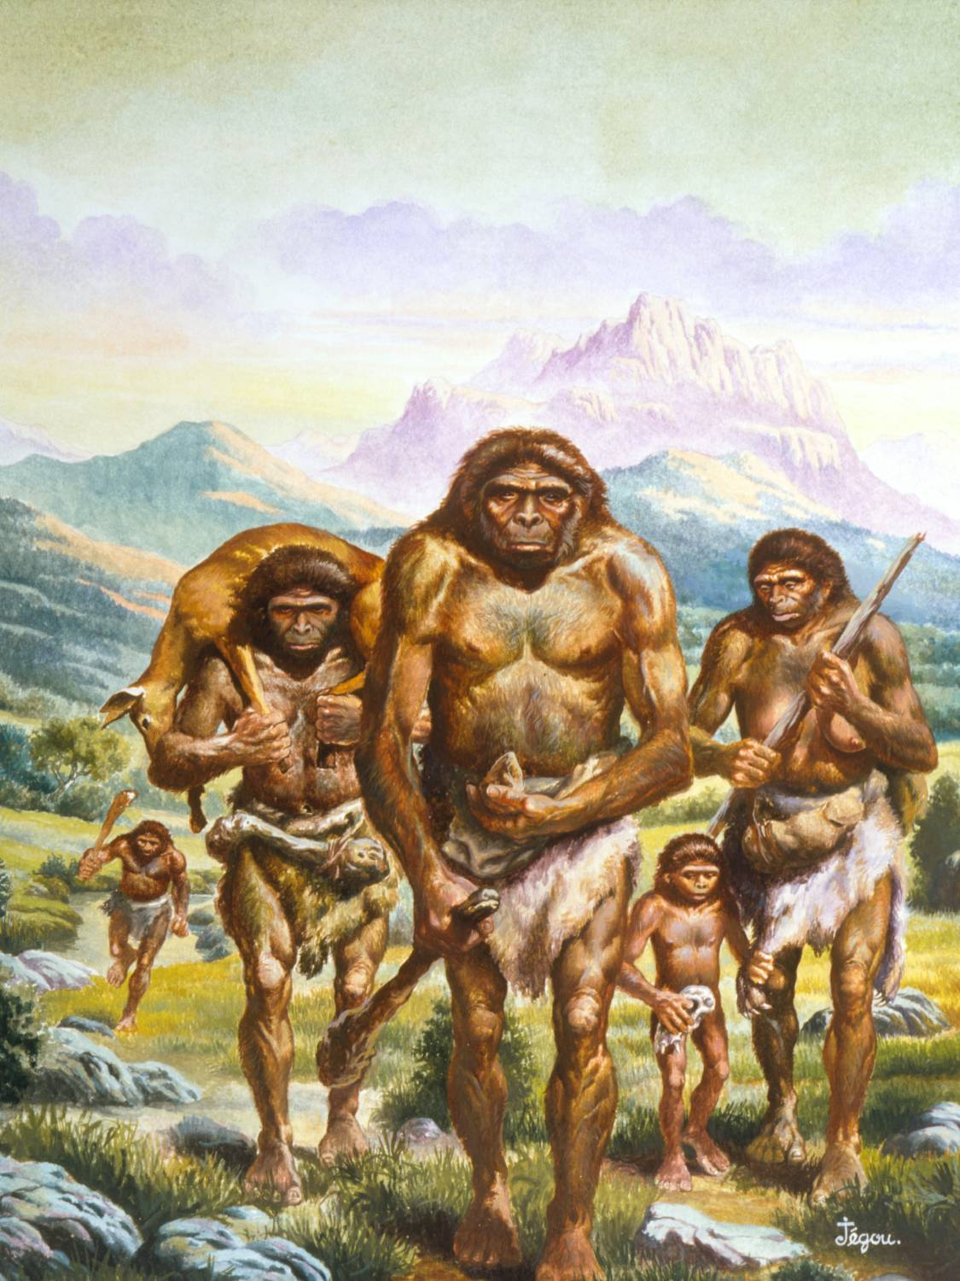
Homo erectus was the first to migrate out of Africa
This development may have allowed early humans to move out of Africa for the first time, probably from about 1.6 million years ago onwards.
These individuals were member of the species Homo erectus - fossils from this species have been discovered in Europe and Asia.
With this species distinctly “human” traits became more developed. They were larger and built more like modern humans and had larger brains than earlier species.

Slide 14
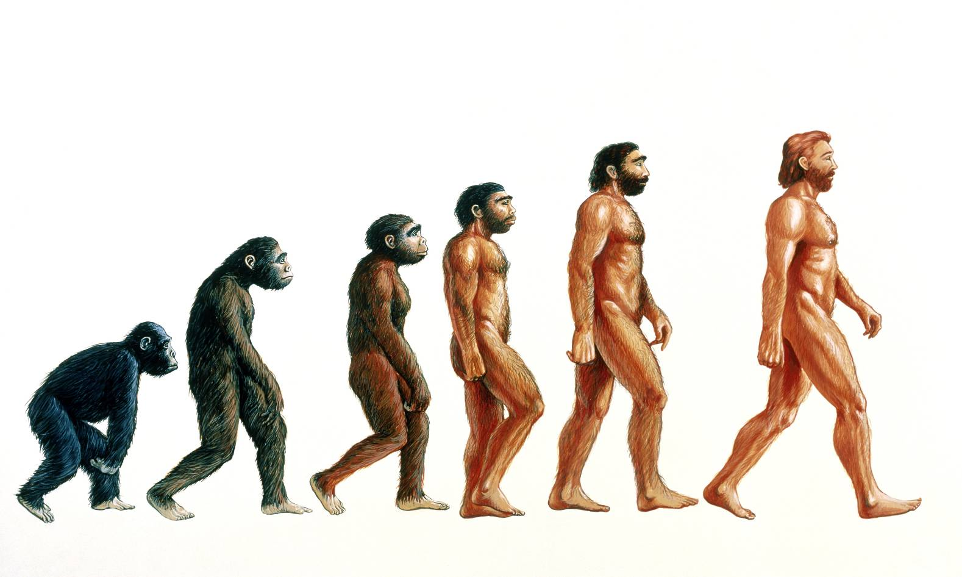
When and where did modern humans evolve?
Homo
neanderthalensis
The earliest anatomically modern Homo sapiens fossils date to only 170,000 years ago. If you look through the fossil record, the average lifespan of a mammal species is 10 million years, so Homo sapiens is a comparatively young species.
By 170,000 years ago there were hominids living in Europe, Africa and Asia. So where and when did modern humans evolve?
Australopithecus
Homo erectus
Homo sapiens
Homo habilis

Slide 15
When and where did modern humans evolve?
Did we evolve from Homo erectus separately in Asia, Africa and Europe?
We know Homo erectus migrated out of Africa about 1.6 million years ago, and hominid populations were living in Europe and Asia. This hypothesis suggests that modern human populations evolved from these ancient populations separately in Asia, Africa, and Europe, but with some interbreeding along the way.
Or did we evolve in Africa and migrate out recently (within the last 100,000 years), replacing existing hominid populations?
Until the 1980s the first hypothesis was favoured – modern humans evolved from Homo erectus separately in Asia, Africa and Europe.
But Rebecca Cann and Allan Wilson showed that modern humans originated in Africa, evolving relatively recently from a small ancestral population. This supports the second hypothesis which is referred to as the “Out of Africa” hypothesis.
Cann and Wilson showed that we can all trace our DNA back to one woman who lived in Africa around 200,000 years ago.

Slide 16
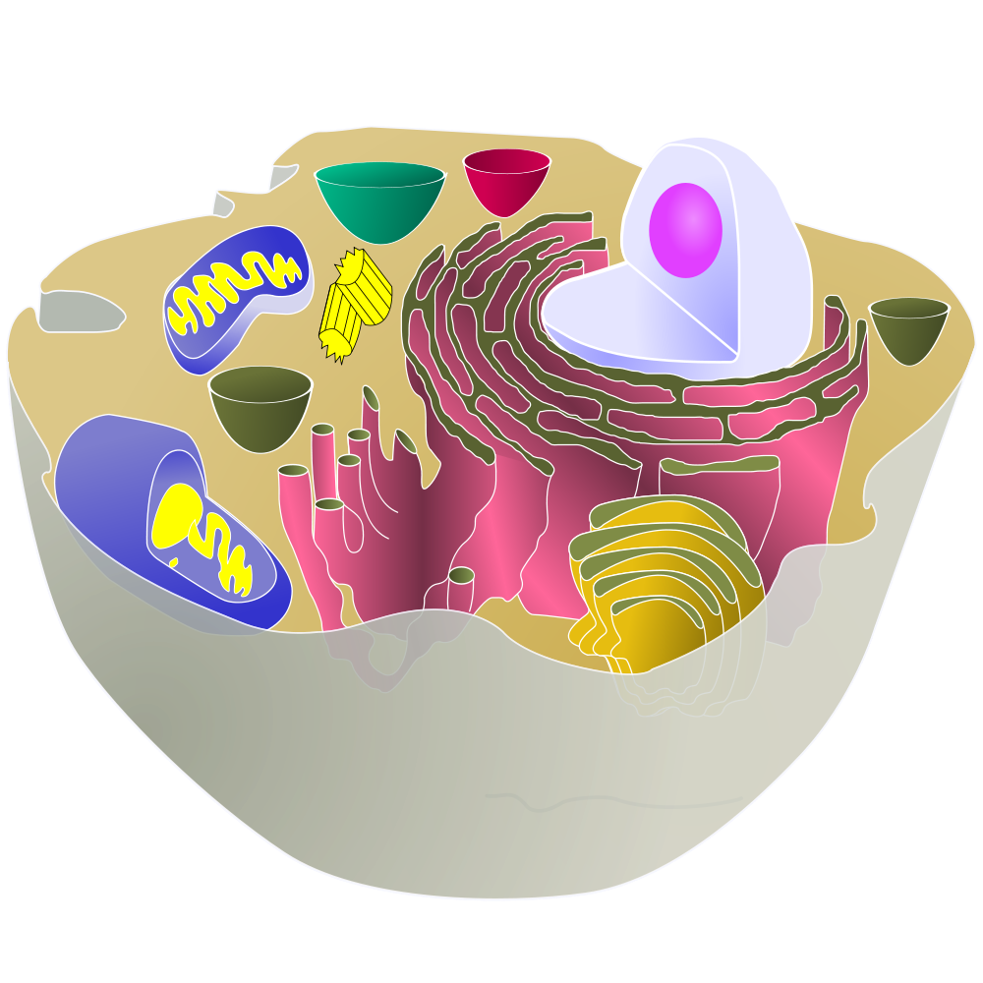
Allan Wilson and Rebecca Cann used mitochondrial DNA to make this discovery.
Mitochondria are cellular structures that convert food into energy that the cell can use. Mitochondria have their own DNA, which is totally separate from the DNA found in the nucleus (where the chromosomes are).
Mitochondria are only found in eggs and not in the head of a sperm, so we only get mitochondrial DNA from our mothers.
Because mitochondrial DNA is only passed down from female to female and doesn’t get mixed with DNA from the father, changes in mitochondrial DNA over time can be easily traced back
Nucleus
Mitochondria

Slide 17
Mitochondrial DNA traces the female line
Allan Wilson and Rebecca Cann studied mitochondrial DNA sequences of people from around the world, and found that they could all be traced back to one common mitochondrial sequence that existed in Africa about 200,000 years ago.
This means that all humans alive today are ultimately descended from one common female ancestor, who we call “Mitochondrial Eve”. Mitochondrial Eve was not the only women alive 200,000 years ago – she was part of a population that would have contained many other women with other mitochondrial DNA sequences. However, over time these other lineages died out one by one, and by chance one lineage replaces all the others.

Slide 18
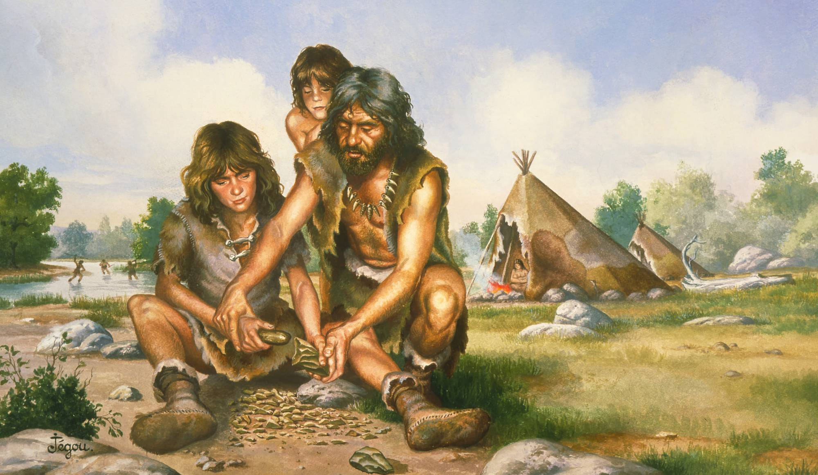
We are all descended from a small population living in Africa 150,000 to 200,000 years ago

Slide 19
Modern Humans
Modern humans began to migrate out of Africa around 100,000 years ago
As humans moved through Europe and Asia they would have met these earlier hominids, like the Neanderthals in Europe.
They largely out-competed and replaced these older species, but there is some evidence that they interbred.
Along the way, human culture as we know it developed – art, clothing, jewellery, music and ceremonies such as burials.

