Slide 1
Kingdom Plantae

Slide 2
4 main groups
Phylum Bryophyta Phylum Pteridophytae
Phylum Gymnosperms Phylum Angiosperms

Slide 3
Phylum Bryophyta
They are non-vascular land plants, which do not contain any conducting tissues and are often referred to as bryophytes.
These plants are small, grow close to the ground and include mosses and liverworts.

Slide 4
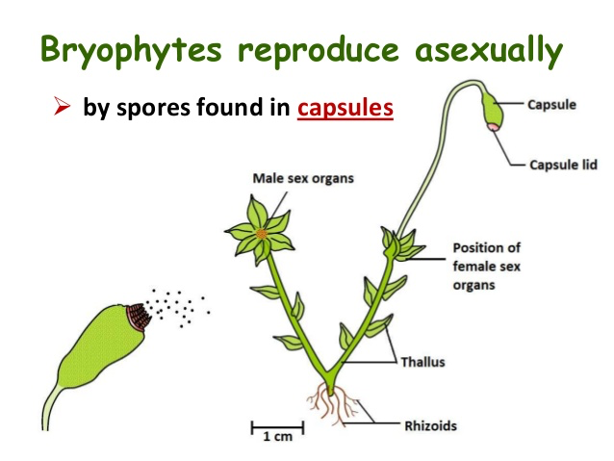
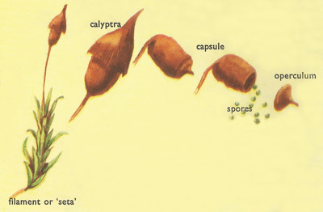
Phylum Bryophyta
The reproduction process is carried in their spores. They are non flowering plant and are found mainly growing on the ground, on other plants and on rocks.
Seedless

Slide 5
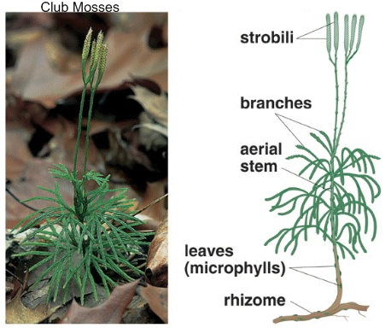
Phylum Pteridophytae
They are seedless vascular plants, which contain vascular tissues but do not produce seeds.
The reproduction process is carried by spores.
e.g.: horsetails, ferns and club mosses.

Slide 6
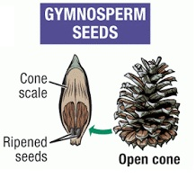
Phylum Gymnosperms
Gymnosperms are non-flowering plants with an exposed seed.
“naked seeds” because they do not have flowers and seeds develop on surface of reproductive structures
Seeds disperse by wind
E.g: palms, carpet lawns, etc.

Slide 7
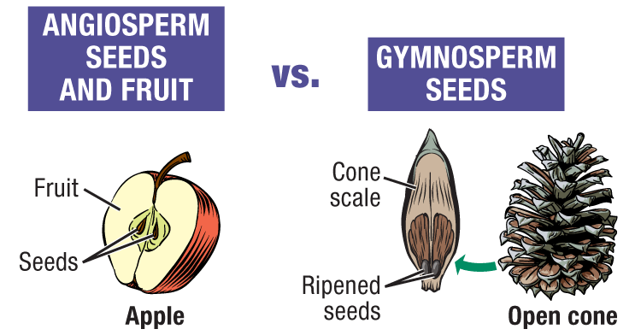
Phylum Angiosperms
Angiosperms are flowering plants, which develops the seeds within a protective structure.

Slide 8
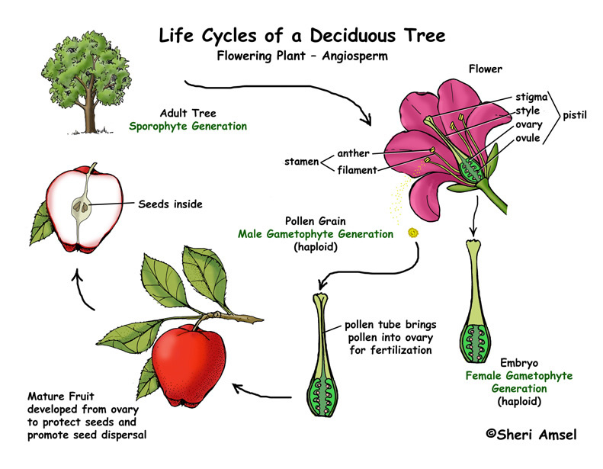
Phylum Angiosperms
They develop their seeds within an ovary, which itself is embedded in a flower. After the stage of fertilization, the flower falls and the ovary bulges to become a fruit.

Slide 9
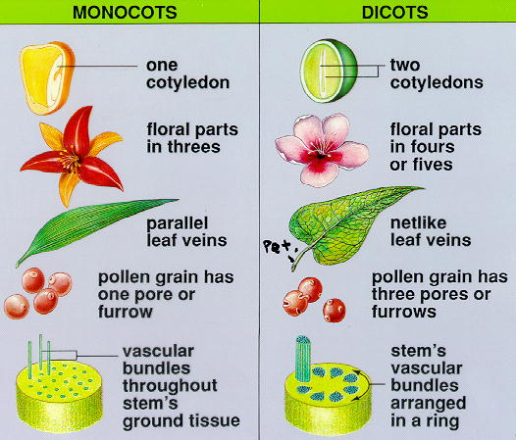
Monocots and Dicots
Monocot
Only one cotyledon in the embryo
Leaf veins are parallel
Petals in multiple of three
Ex) Grains, lillies, daffodils, onions,

Slide 10
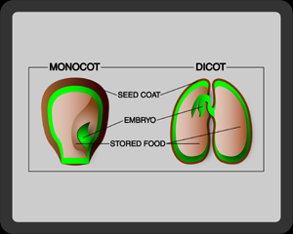
Dicots
two cotyledon in the embryo
Leaf veins are vein-like
Petals in multiple of four or five
Legumes (pea, beans, lentils, peanuts) daisies, mint, lettuce, tomato and oak are examples of dicots.

Slide 11
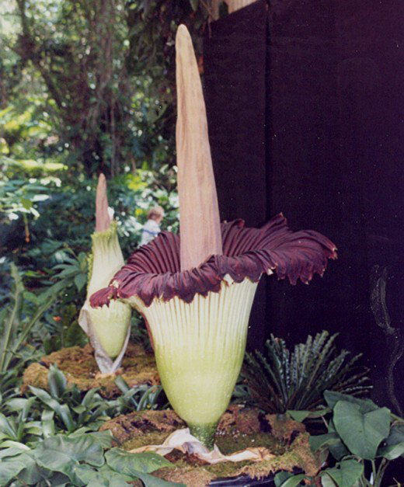
The Corpse Flower
Amorphophallus titanum
The Corpse Flower smells strongly like a rotting corpse.
It comes from the forests of Sumatra. It's not actually one big flower; it’s thousands upon thousands of little male and female flowers. These exude oils, while the center collects heat. The heat plus the oils create the smell that attracts the beetles that pollinate the flower.
In case you were wondering, a mature plant can weigh 200 pounds.
https://www.youtube.com/watch?v=l-uK5ulLBr8

Slide 12
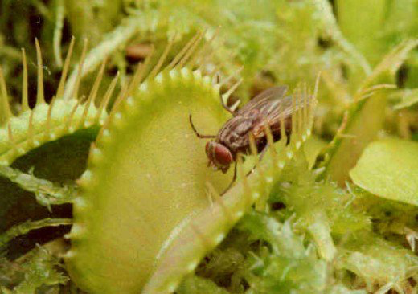
Venus Fly Trap
Dionaea muscipula
It's carnivorous. Not many plants eat things other than sunlight, and not many are capable of rapid movement.
Boggy areas of North and South Carolina, where the soil is poor in nutrients. Therefore, it craves a high-nitrogen snack once in a while.
Trap is triggered with trigger hairs. When 2 hairs are touched within seconds of each other, or if a single hair is touched twice, the trap snaps shut.
The jaw-looking things act like interlocking fingers, or to the insect inside, prison bars. They do their best to restrain the insect from escaping.
https://www.youtube.com/watch?v=ii_ygm4K5n0

