Slide 1
Evidence and Phylogenetic trees

Slide 2
EVIDENCE USED IN CLASSIFICATION
Taxonomists, the scientists who study classification, attempt to arrange organisms into groups based on evolutionary relationships
The evolutionary history of a species is called it’s phylogeny
Phylogenetic relationships are determined by the following evidence:
1. Comparative morphology
2. Embryology
3. Chromosomes/DNA
4. Biochemistry

Slide 3
Phylogenetic Trees
A tree showing the evolutionary relationships among various biological species that are believed to have a common ancestor
Each branch with descendants represents the most recent common ancestor of the descendants
The line lengths can correspond to time estimates

Slide 4
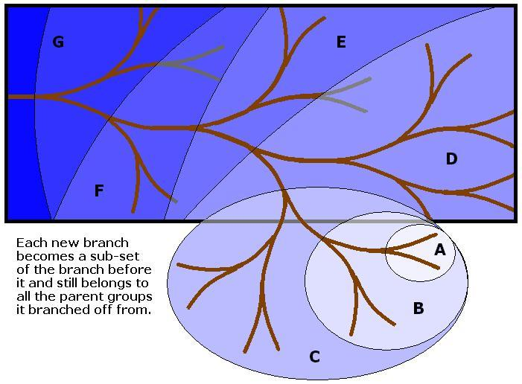
Phylogenetic Tree

Slide 5
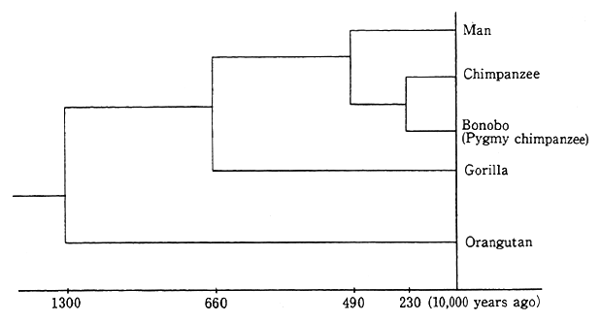
Phylogenetic Tree

Slide 6
1. COMPARATIVE MORPHOLOGY
Comparison of the structure of organisms
May not be enough by itself to accurately identify classify an organism
E.g. analogous structures look similar but share no common ancestry (organisms are not related) ex. Wings
Similar structures = similar instructions = similar DNA = common ancestor

Slide 7
2. EMBRYOLOGY
Similarity and differences of embryonic structures and tissues and developmental patterns can determine how closely related organisms are
Similar embryology = similar instructions = similar DNA = common ancestor

Slide 8
3. CHROMOSOMES/GENETICS
Comparison of the chromosomes/genes of different organisms
Can compare chromosome numbers/shapes
Can compare actual DNA sequences
Similar genetics = similar instructions = similar DNA= common ancestor

Slide 9
4. BIOCHEMISTRY
Comparison of organisms' biochemistry:
Comparing simple and complex molecules like proteins and amino acid sequences
Similar biochemistry = similar instructions = similar DNA = common ancestor

